Slide 1
Population Health Status at the Service Delivery Area
Neighbourhood Mapping and Analysis
Liz Corson, Epidemiologist
Toronto Public Health

Slide 2
Population Health Status at the SDA
    Outline:
    Service Delivery Areas (SDAs)
    Health Surveillance Indicators
    Topics and data sources for SDA analysis
    Issues with SDA analysis
    Communication Challenges
Notes:
I am going to be speaking about some work I have done producing health status estimates at the sub-Toronto level, and some challenges I have faced with analysis of some of the types of data I have used, as well as challenges communicating the information to ensure that it is interpreted correctly
2

Slide 3
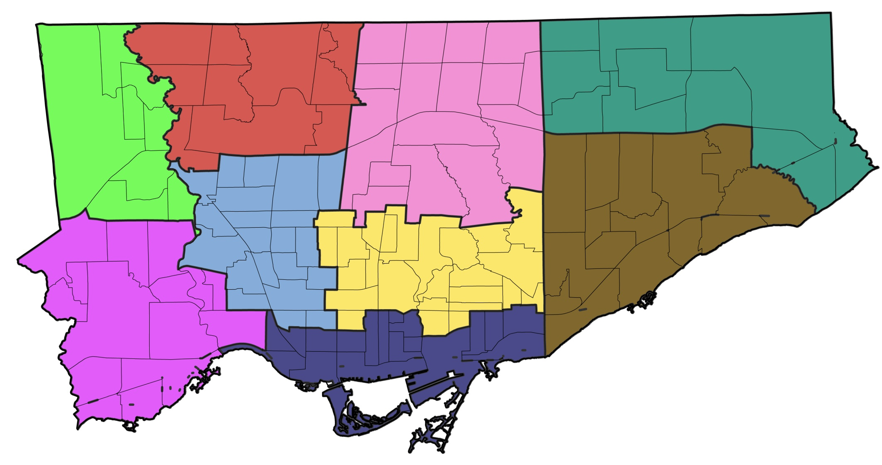
Service Delivery Areas (SDAs)
Notes:
To facilitate planning and staffing, Toronto Public Health spatially divides the city into sub-Toronto service delivery areas (SDAs)
These SDAs shown on the slide are used for chronic disease and injury prevention service planning
They were created using Toronto’s neighbourhoods as building blocks
I won’t get into too much detail about Toronto’s neighbourhoods, but they were created from census tracts by Toronto Public Health in partnership with a team from the social development, finance and administration department of the City in 2001, and are used widely by municipal staff as well as other researchers
When having general discussions about health status information with staff and management, the need for estimates at these SDAs always emerges as a priority
The need makes sense to want to use health status evidence in planning processes.
For example, if TPH is looking to pilot some new diabetes prevention programs, doing so in the SDAs with the highest diabetes incidence makes sense – you want to go where the need is.
3

Slide 4
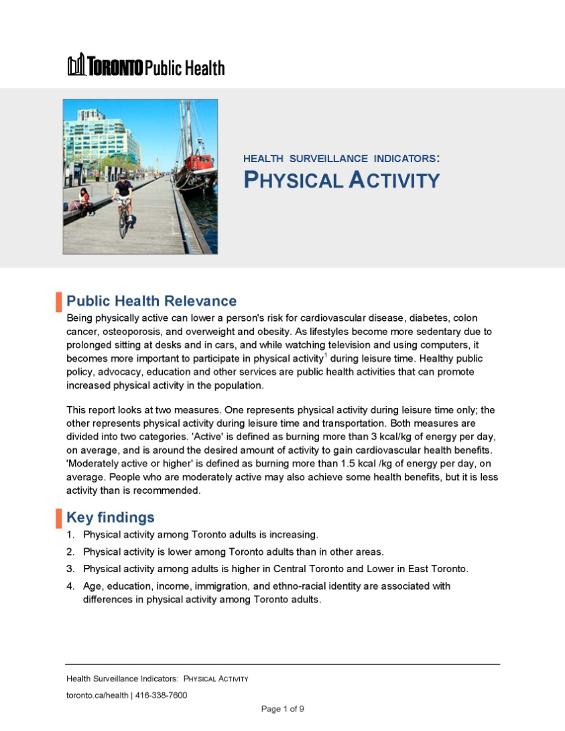
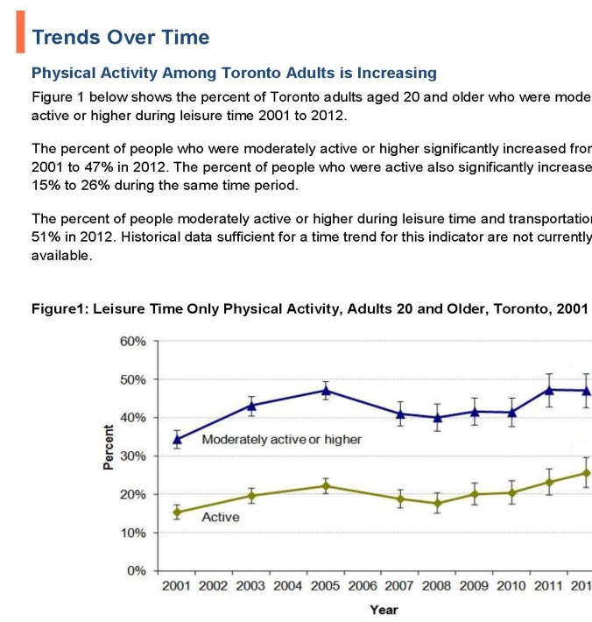
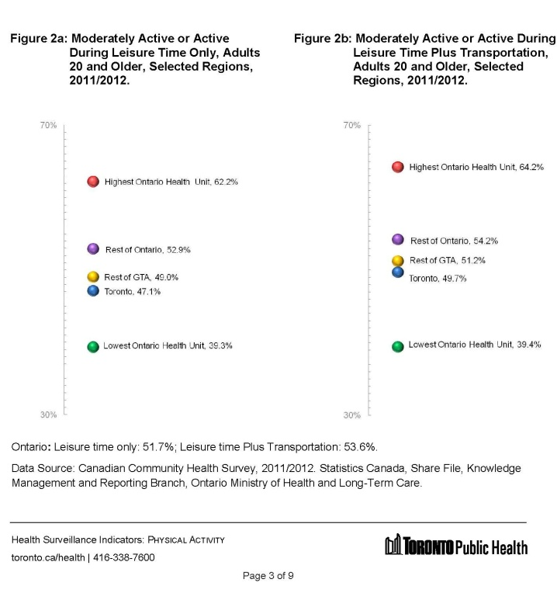
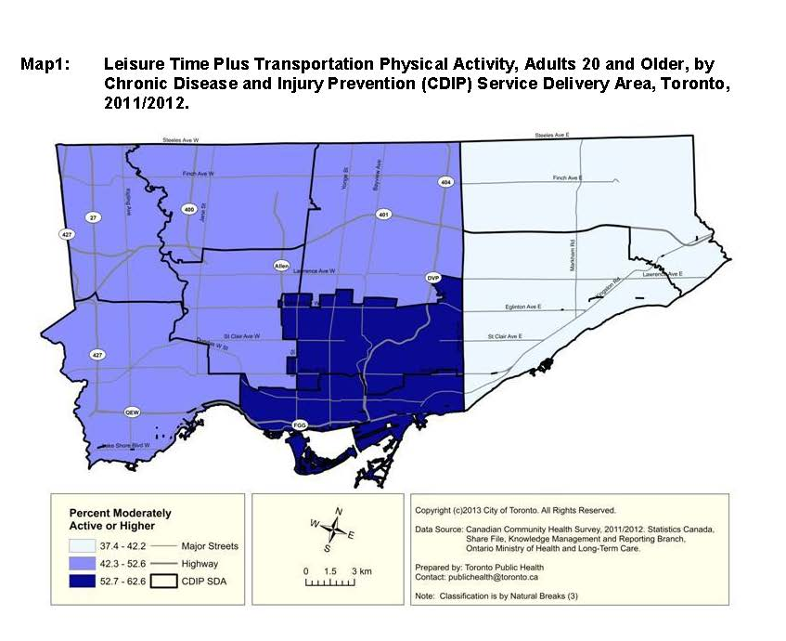
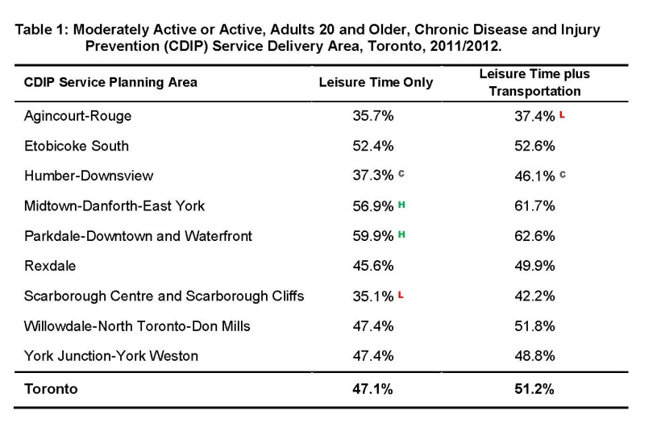
Health Surveillance Indicators
Notes:
One of my roles as a non-communicable disease epidemiologist at Toronto Public health includes population health assessment and surveillance
To help fulfill this requirement, my team and I create mini health status reports on health status indicators. My work has focused on chronic disease prevention, so the reports I have worked on explore risk factors for chronic diseases and chronic disease themselves.
Each report is on one main indicator, and there is a time trend, a comparison to other regions in Ontario, and analysis by socio-demographic characteristics, they include an analysis of each indicator by SDA
4

Slide 5

Health Surveillance Indicators
  SDA Team Meetings
    Health status profile
    New data
    Comparisons
    Discussion
Notes:
I also visit management and staff meetings when new data is released and provide a health status profile of each SDA, that includes new estimates, old estimates, comparison to the city total, and a rank for that SDA. These include risk factors as well as information on diseases
I am really happy and excited to do this, because I know it means that people are interested in using health status data, and I have participated in some great discussions spurred by some of the health status estimates that I present.
But I often encounter difficulties explaining possible reasons for why the data are as they are, and next I will give a bit of background to explain why these difficulties come to be

Slide 6

Key Health Status Information
  Modifiable Risk Factors for Chronic Disease:
    Smoking
    Physical Activity
    Sedentary Behaviour
    Eating Behaviour
    Body Mass
Notes:
The most useful information for chronic disease and injury prevention planning at the SDA level is the prevalence of risk factors for chronic disease, for example, what percent of each SDA smokes, is overweight/obese, is physically inactive, or doesn’t eat a healthy diet
Information on the incidence and prevalence mortality and hospitalization for chronic diseases, such as heart disease and cancer, is somewhat useful, but our main goal in public health is prevention –we want to do all we can to prevent chronic diseases before they happen. So we’re looking to catch risky lifestyle factors before they lead to diseases.
6

Slide 7

Data Sources
  Administrative and Registry Data
    Diseases
    Incidence, hospitalization, mortality
    Good for small area analysis
  Survey Data
    Risk Factors
    Prevalence
    Questionable for
    small area analysis
Notes:
There are two main types of data sources for chronic disease and injury prevention indicators: administrative or registry data, and survey data.
Incidence, hospitalization, and mortality for chronic diseases, those indicators that I said are of secondary importance for program and service planning, come from administrative and registry data. These data sources count almost everyone who gets said disease, is hospitalized for it, or dies from it, so they can these data sources can give us reliable estimates at a small geography
But information on current risk factors – those things that are modifiable right now to prevent disease – has to come from survey data
Surveys only captures a small percent of the population we are looking at. One year of Canadian Community Health Survey data – that's the CCHS - for Toronto has about 1700 people representing 2.7 million. Statistically, this is ok – in theory a big enough simple random sample can represent a population on most things.
But the main problem with surveys is that they are voluntary, and response rates these days are not that good. The people who respond to surveys are different, on average, than those who don’t.
We know this by comparing surveys to the old long-form census. The CCHS, from which a lot of our data on risk factors come, for example under-represents low-income people, recent immigrants, and those with low education in Toronto. Other surveys, such as the Rapid Risk Factor Surveillance System have similar issues. I think everyone in this room knows that those demographic characteristics are related to health – they’re major social determinants. So if we’re under-representing those people, we are probably not getting accurate health status estimates either
7

Slide 8

Problems with SDA Survey Estimates
  Smaller sample size
    Less precise estimates (wide CIs!)
  Variable response rates
    Less comparable estimates
  Poorer representivity
    Less accurate estimates
Notes:
These problems with survey data are worse when you get down to smaller areas.
First, your sample size decreases, which means that the precision of your estimates decreases. That means that your confidence interval increases, and you are not as sure that the true estimate is close to the one that was yielded from your sample
That means, that from one year to the next, it could look like there was a big change in the estimate, but when you test for ‘statistical significance’ there is no difference.
Second, response rates might be different in different areas, so your comparisons between areas might not be appropriate
When we are doing secondary data analysis, in other words, using data that has been collected by other people, we are not able to access response rates at any geography we desire – we can only use the response rates that are released.
Another issue with a smaller sample size is that your sample is less likely to represent the population in your small areas, so, if our survey data already under-represents new immigrants at the Toronto level, the chances are that in some of the SDAs, this under-representation might be even worse, to the point that it is unacceptable. Without the long-form census, we can’t even evaluate that anymore.
8

Slide 9
Problems with SDA Survey Estimates
    All of these issues now also
    apply to demographic data!
    Long-Form Census vs. National Household Survey (NHS)
Notes:
In fact, all of the issues I have just discussed apply to the NHS itself. We used to use the long-form census to evaluate the quality of our survey data. Now, not only do we no longer have that option, we don’t have demographic data we can trust, either. This issue doesn’t only effect the public health and health sectors, but all across the public service and research spectrum.

Slide 10
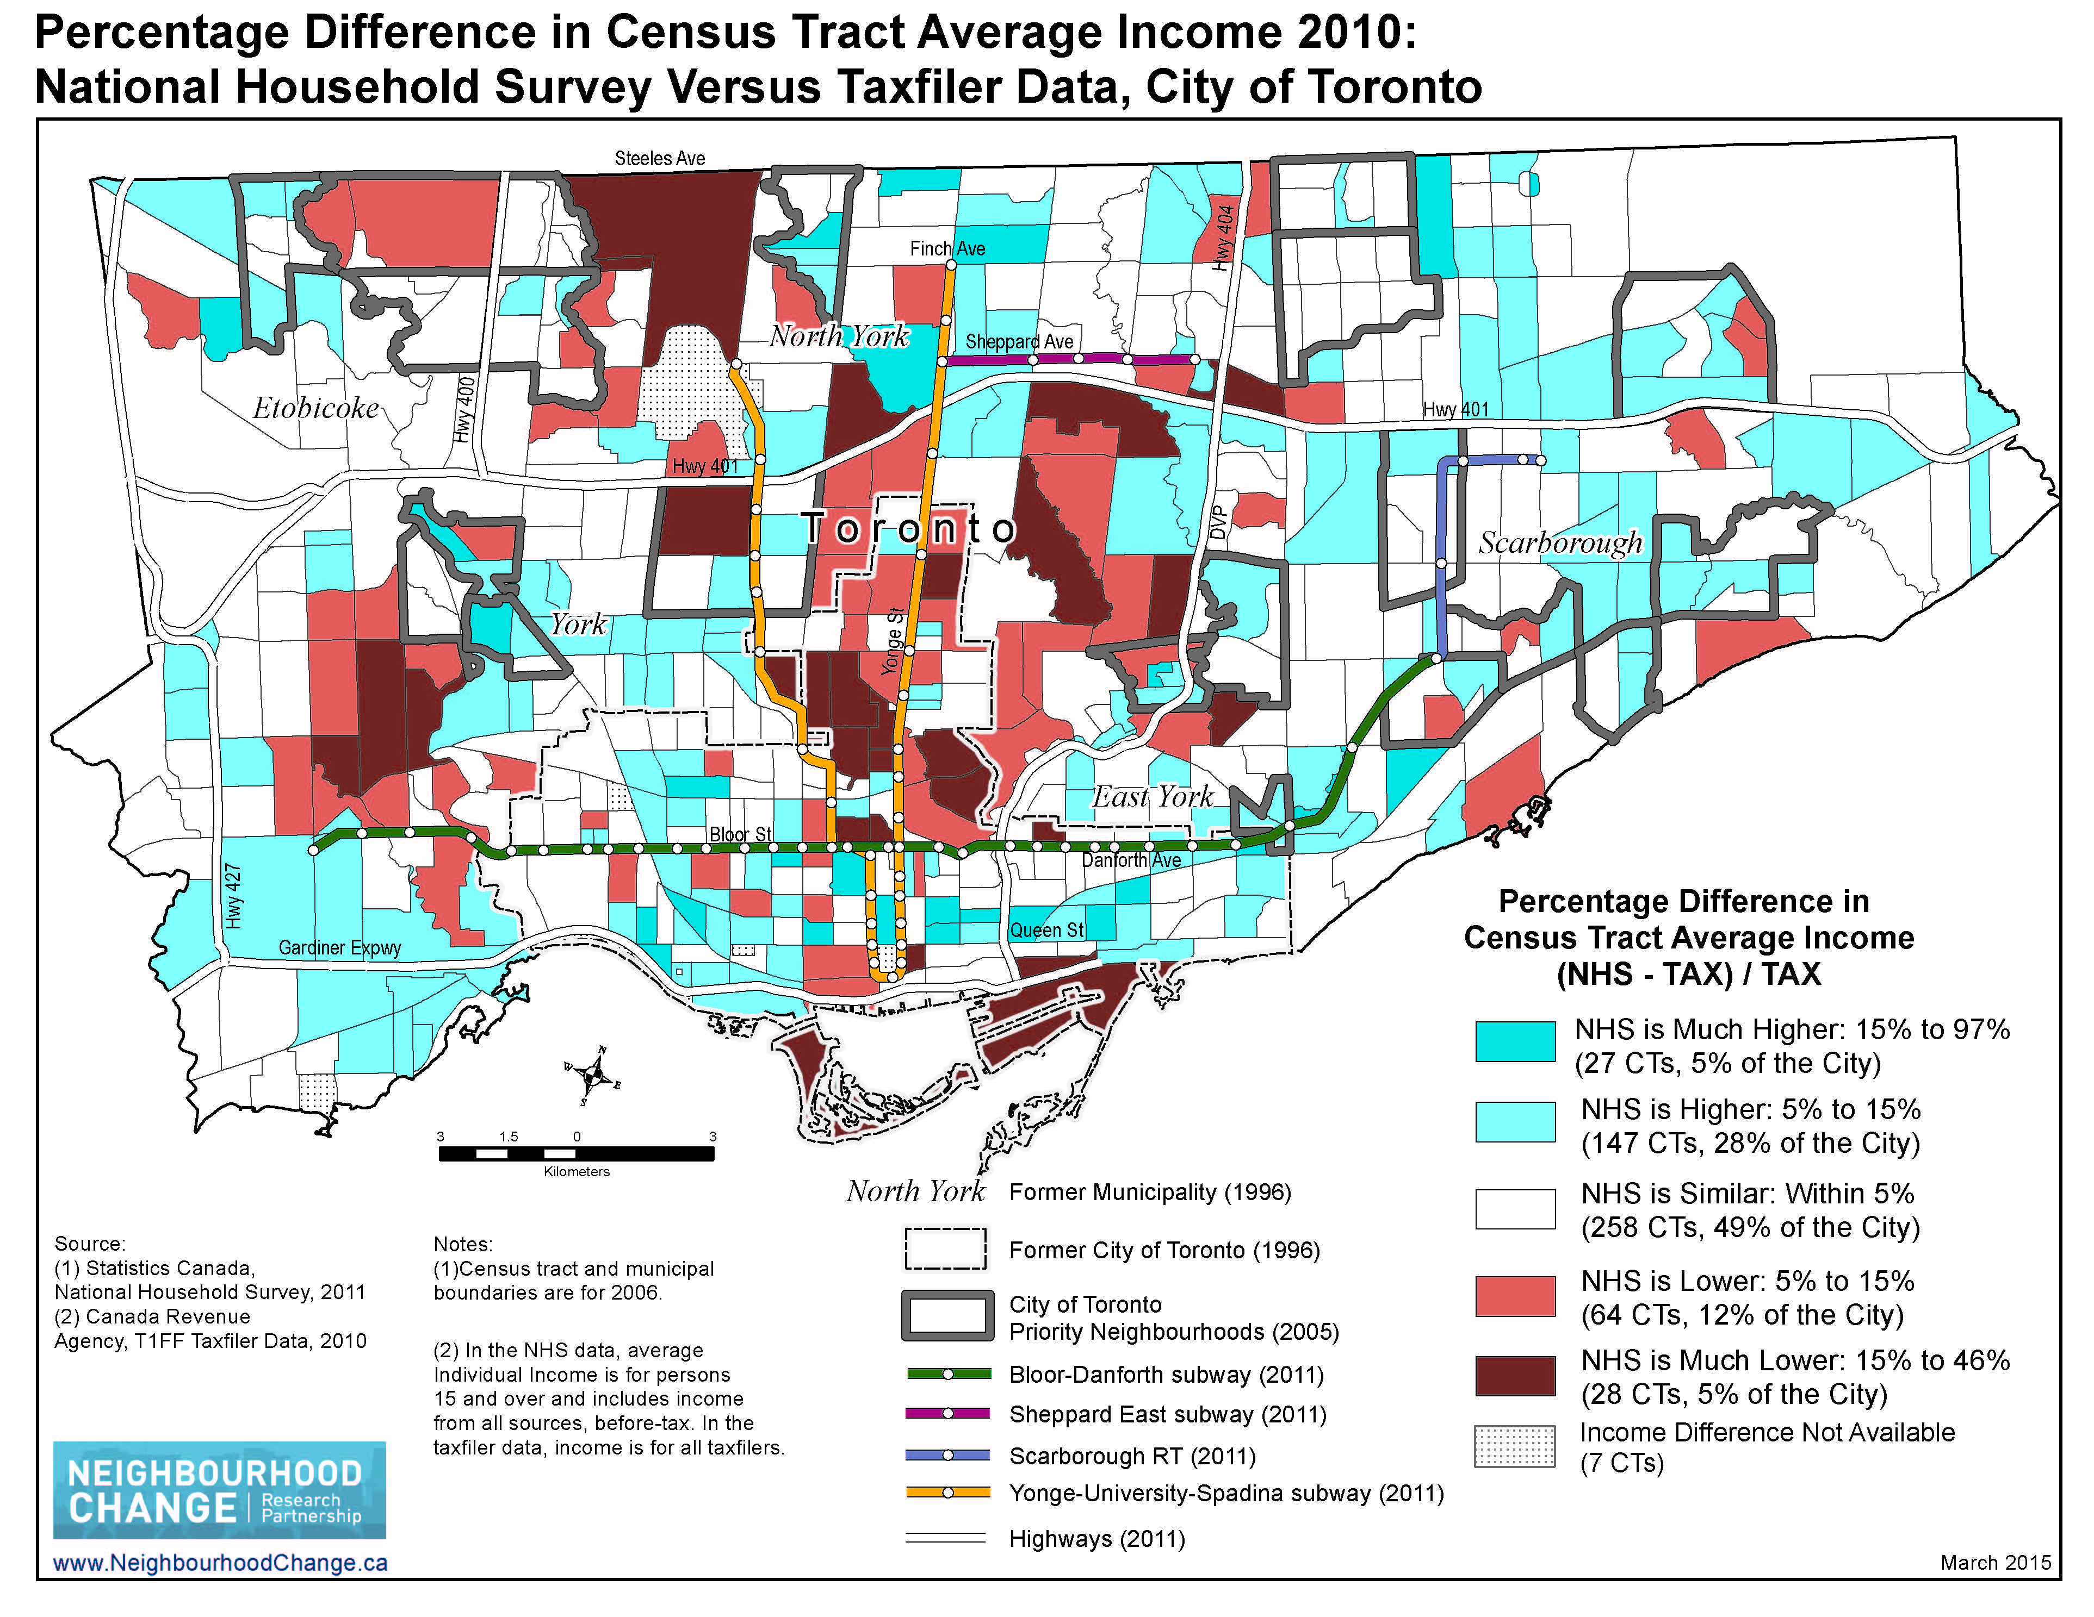
Notes:
This map provides an example of the use of survey data at the small area level. This shows a comparison of tax-filer data-based average income vs. NHS data average income in each census tract.
It is part of the work done by the Neighbourhood Change Research Partnership at the U of T. Blue CTs are those where the NHS data gives us an average income value 5% to 97% higher than the tax filer data, which is currently considered to be the best source for income information. Red shows areas where the NHS low-balled the average income by 5% to 46%.
The NHS has a much bigger sample size than the health surveys we use, so if that survey has these problems, the chances are, ours do too.

Slide 11

Solution??
    Combining years of data??
      Assumes demographic consistency
Notes:
A way to battle some of the problems is to combine years of survey data, to get a bigger sample size that is hopefully more representative of the population of our SDAs. But then you also have to think about whether this is appropriate: Toronto has a high rate of immigration and mobility. There are many examples in Toronto where large condo developments, gentrification, immigration, and exodus to other regions of the GTA have drastically altered the populations in certain neighbourhoods. So, is it appropriate to combine data from 5 years ago with data from today, when the people who answered the surveys 5 years ago might not even live in that area anymore? It’s hard to say
11

Slide 12

‘Flawed Data is Better than No Data’
Notes:
So I’ve talked about all these problems with small area anaylysis of survey data, but, we still do it. We still produce and release the estimates. There are some that small area analysis shouldn’t be done at all, and especially not with survey data, the general feeling is that it’s the best we have, and our flawed data is better than no data at all.
But the challenge is making decisions about when the analyses are appropriate, and communicating the faults in the data to information users, so that they can properly interpret it for decision making. This can be quite a struggle.
12

Slide 13

Communication Challenges
    Ranking SDAs
    Changes in SDA estimates from one year to the next
    Differences in risk factor profile vs. disease profile
Notes:
One of the requests I got early on was to rank the SDAs from 1 to 9 for each indicator, so when I visit the team meetings, the team have an idea of how they're doing in relation to other SDAs, as well as the Toronto total
One of the issues I have with this is that the SDA estimates are most often not statistically significantly different from each other. Often the highest and lowest one or two are different from each other, but for some indicators this isn't the case at all. So I often have to explain to the group, yes, your ranking is 1 or 9 or whatever for that indicator, but you have to take this with a grain of salt, because we are not confident that there are any true differences
You may ask, why provide a rank for that indicator, or why agree to ranking at all… but I find it is important to be flexible on my methodological principles when getting requests from data users, because the more you say no, the less likely they are to come to you for the data in the first place.
A similar issue often comes up when there is a change from one year to another in a particular indicator. Because the precision for our SDA estimates is low, there might be a change of 10 percentage points from one year to the next in, let's say, meeting the physical activity guidelines, but scientifically, this does not represent a true change because the estimates are not statistically significantly different.
Risk factor and disease profiles different – people often have difficulty understanding when their SDA is doing well in the ranks in terms of risk factors, but poorly in terms of chronic diseases. It can be difficult to explain the concepts of disease lag time in the context of changing demographics. For example, the people who are dying from lung cancer in your SDA may not represent the same groups of people who are choosing to avoid smoking now. It takes years for risk factors to turn into diseases, and a lot of mobility and migration can happen in the meantime
13

Slide 14

Communication Challenges
    Over-emphasis on environmental factors
    Anecdotal evidence vs. research evidence
    Why we can’t go smaller
Notes:
People looking to blame something environmental or geographic – 'what is it in my neighbourhood that is making people sick?' – a lot of people automatically think of an environmental exposure, but most often, health status in a particular area is more likely to be related to the social determinants of health in that area, than the environment (not to say that the environment doesn't play a role – it definitely does – but it is not the only thing
Teasing out people’s experiences from what the data says – 'the group that I work with all have diabetes. How can our sda have a low diabetes rate?' – explanation that SDAs are still large – there are still hundreds of thousands of people living in them, so one person's experience, no matter how diverse, is not going to represent the entire area
Talk about why we don’t do Ward or nhood estimates in toronto
14

Slide 15
Population Health Status at the SDA
    Summary:
    SDA population health status data useful
    Small area analysis has limitations
    Communication to facilitate interpretation and use is key
Notes:
SDA population health status data is a useful tool for helping to understand populations and plan programs and prioritize service delivery in certain areas
Small Area analysis has its limitations, particularly for survey data
The data can still be used as long as these limitations are communicated to data users in a way that facilitates their use of the information, but also their choice not to use the information in some situations.

