Slide 1
Understanding Peel’s Landscape Through the Use of Peel Health Data Zones
David Guillette
December 15, 2023

Slide 2
Peel is not homogenous

Slide 3
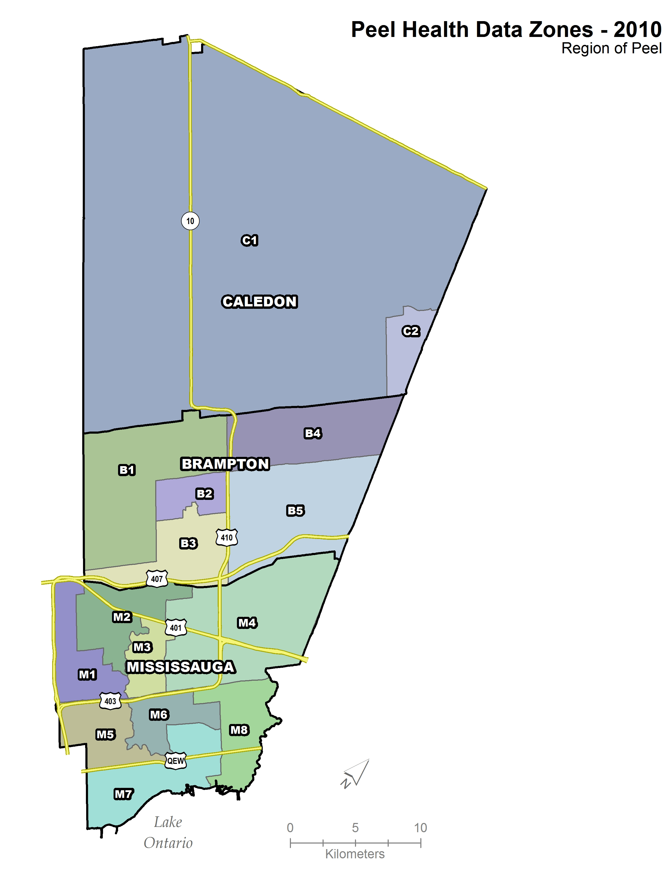
Original Boundaries
15 Peel Health Data Zones; based on 2006 Census data
Population ranged from 65,000 – 132,000; smaller in Caledon (~30,000)
Large areas and populations made variations between PHDZs difficult to discern
Peel has grown to include ~150,000 additional residents from 2011-2021

Slide 4
Methods
Initial research scan evaluated methods and considerations for similar projects completed at City of Toronto, City of Ottawa, City of Hamilton, Durham Region Public Health, Muskoka -Simcoe Public Health, and Health Commons Solution Lab.
An informal literature review was carried out to help determine which census variables are commonly used to reflect the SDOH. Reports and papers included: Canadian Deprivation Index, Socioeconomic Factor Index, Canadian Marginalization Index, Early Childhood Mapping Project Index, and the Region of Peel Comprehensive Health Status Report
Census tracts (CTs) were selected as the geographic unit for aggregation. CTs are small enough to capture local variation and large enough to avoid issues related to data suppression.
Principal component analysis (PCA) used to determine which Census variables best explained socioeconomic and demographic variation among geographic units.
Literature identified 20 census variables that reflect the social determinants of health. PCA reduced this set of variables to 8 which were used to create a SDOH index to guide PHDZ delineation.

Slide 5
Methods
PCA was performed using standardized values for 20 census variables which identified two components.
Factor scores form the two components were extracted and used to create a composite score for each census tract using the simple average of the two scores.
The composite score was normalized using min-max normalization to aid interpretability and compatibility with spatial analyst tools (positive values are required as input for hot spot analysis).
Normalized composite scores were used as input into the Global Moran’s I Test of Spatial Autocorrelation (large-scale variation). This test informs whether census tracts with similar index values are distributed in clusters, distributed randomly, or dispersed. The results were significant
Cluster and Outlier Analysis (Anselins’s Local Morans I – small-scale variation) was run to identify which census tracts cluster based on a similar composite score and which census tracts differ significantly from adjacent census tracts (outlier). This information aided in delineating data zones by avoiding the grouping of contiguous census tracts where outliers are located.

Slide 6
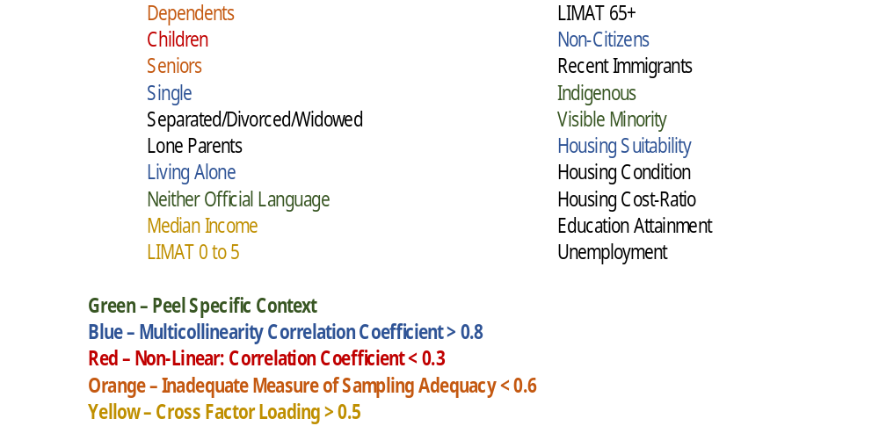
Results
Kaiser-Meyer-Olkin (KMO) = 0.816
Individual KMO = 0.651 to 0.936
Bartlett’s test of sphericity = (p < 0.001)
The PCA revealed two components based on the Kaiser criterion (Eigenvalues > 1)
The two-component solution explained 72.7% of the total variance.
The interpretation of the components was consistent with the impact of SDOH on health outcomes and explained the following aspects: new immigrant families and low income single-parents and seniors.

Slide 7
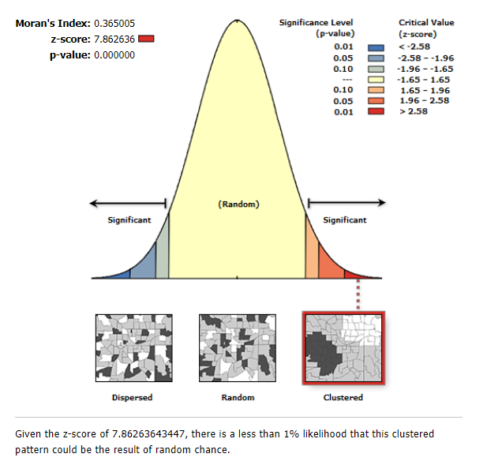
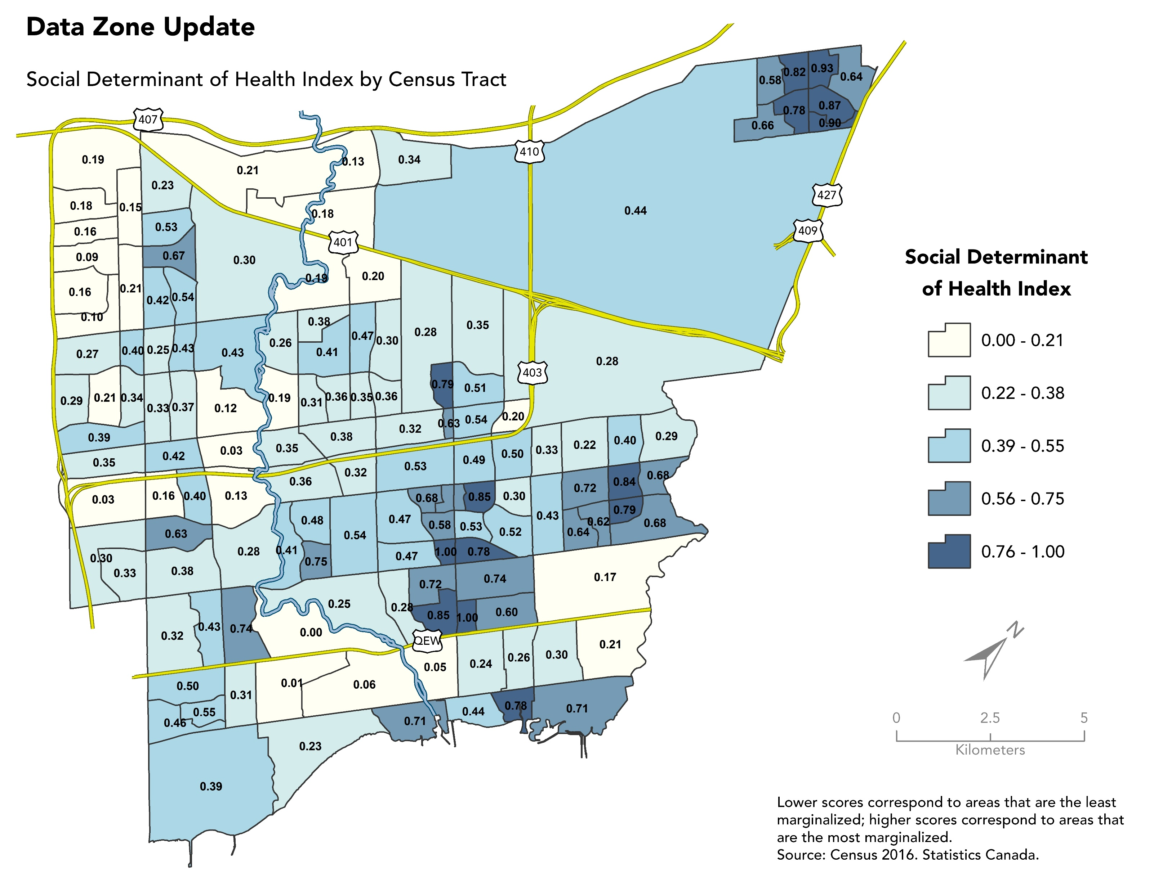
Results
FOR INTERNAL PLANNING USE ONLY.

Slide 8
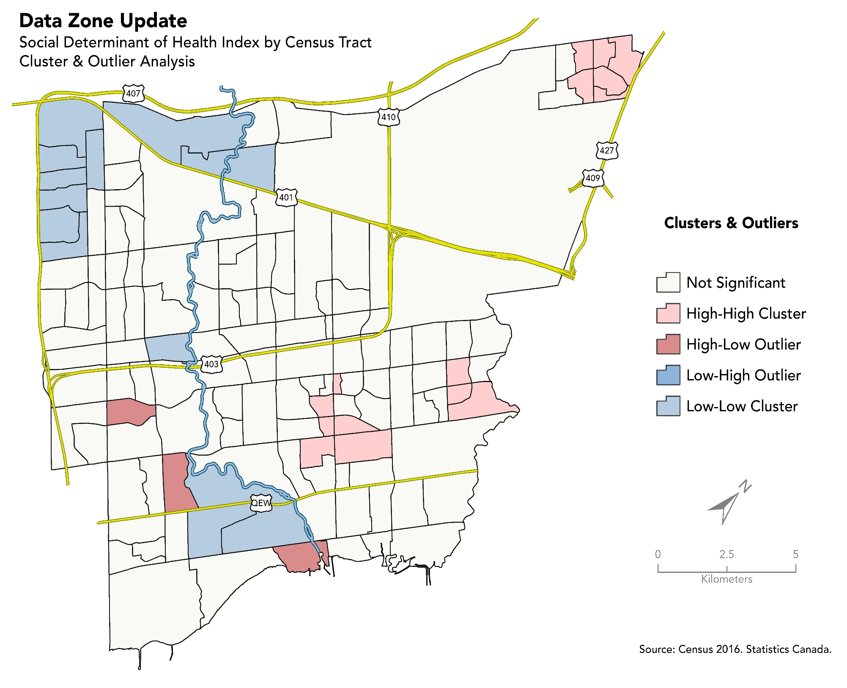
Results
Cluster and Outlier Analysis (Anselins’s Local Morans I) was run to identify which census tracts cluster based on a similar composite score and which census tracts differ significantly from adjacent census tracts (outlier). This information aids in delineating data zones by avoiding the grouping of contiguous census tracts where outliers are located.

Slide 9
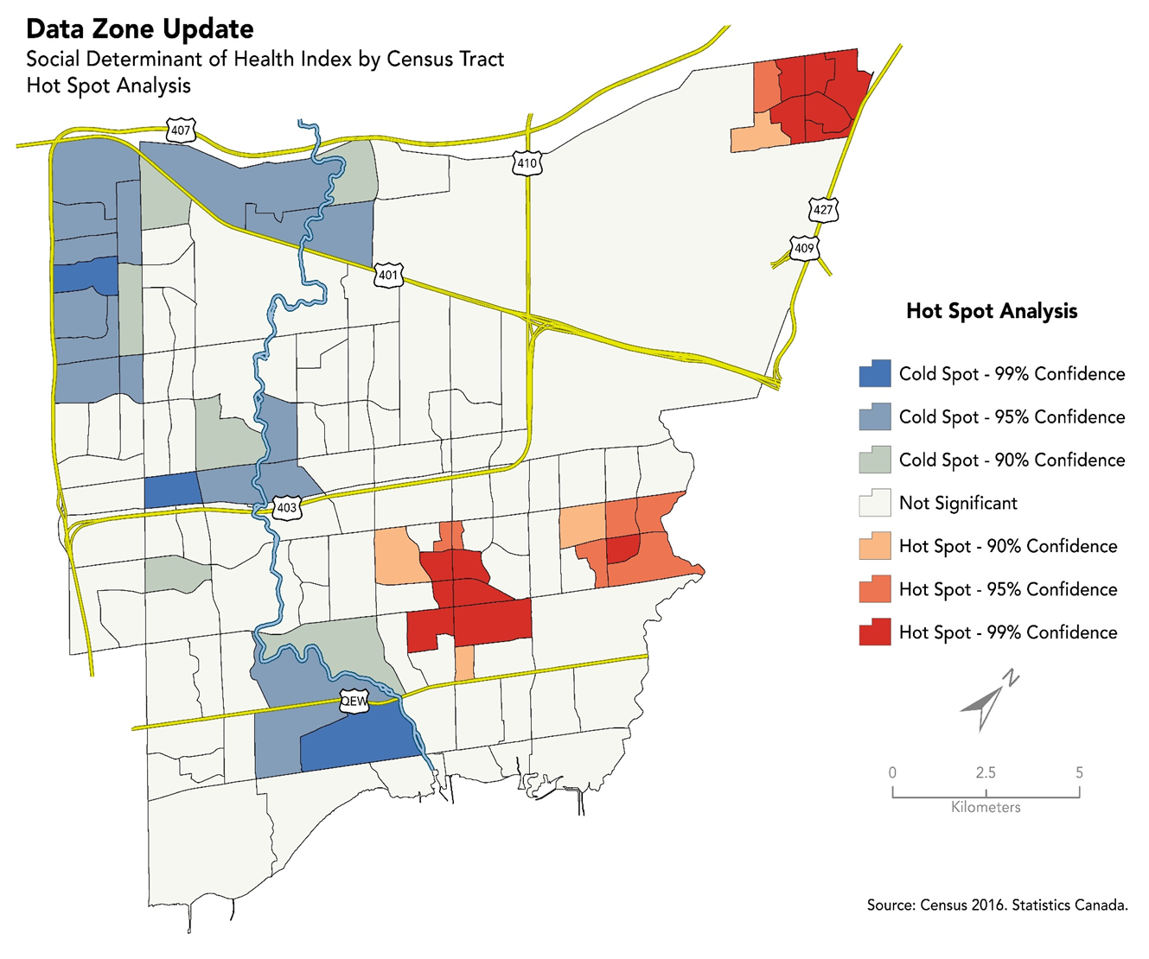
Results
Hot Spot analysis (Getis-Ord*) was conducted using the composite score as inputs to identify areas of high and low clustering among census tracts based on common scores. A feature with a high value is interesting but may not be a statistically significant hot spot. To be a statistically significant hot spot, a feature will have a high value and be surrounded by other features with high values as well.

Slide 10
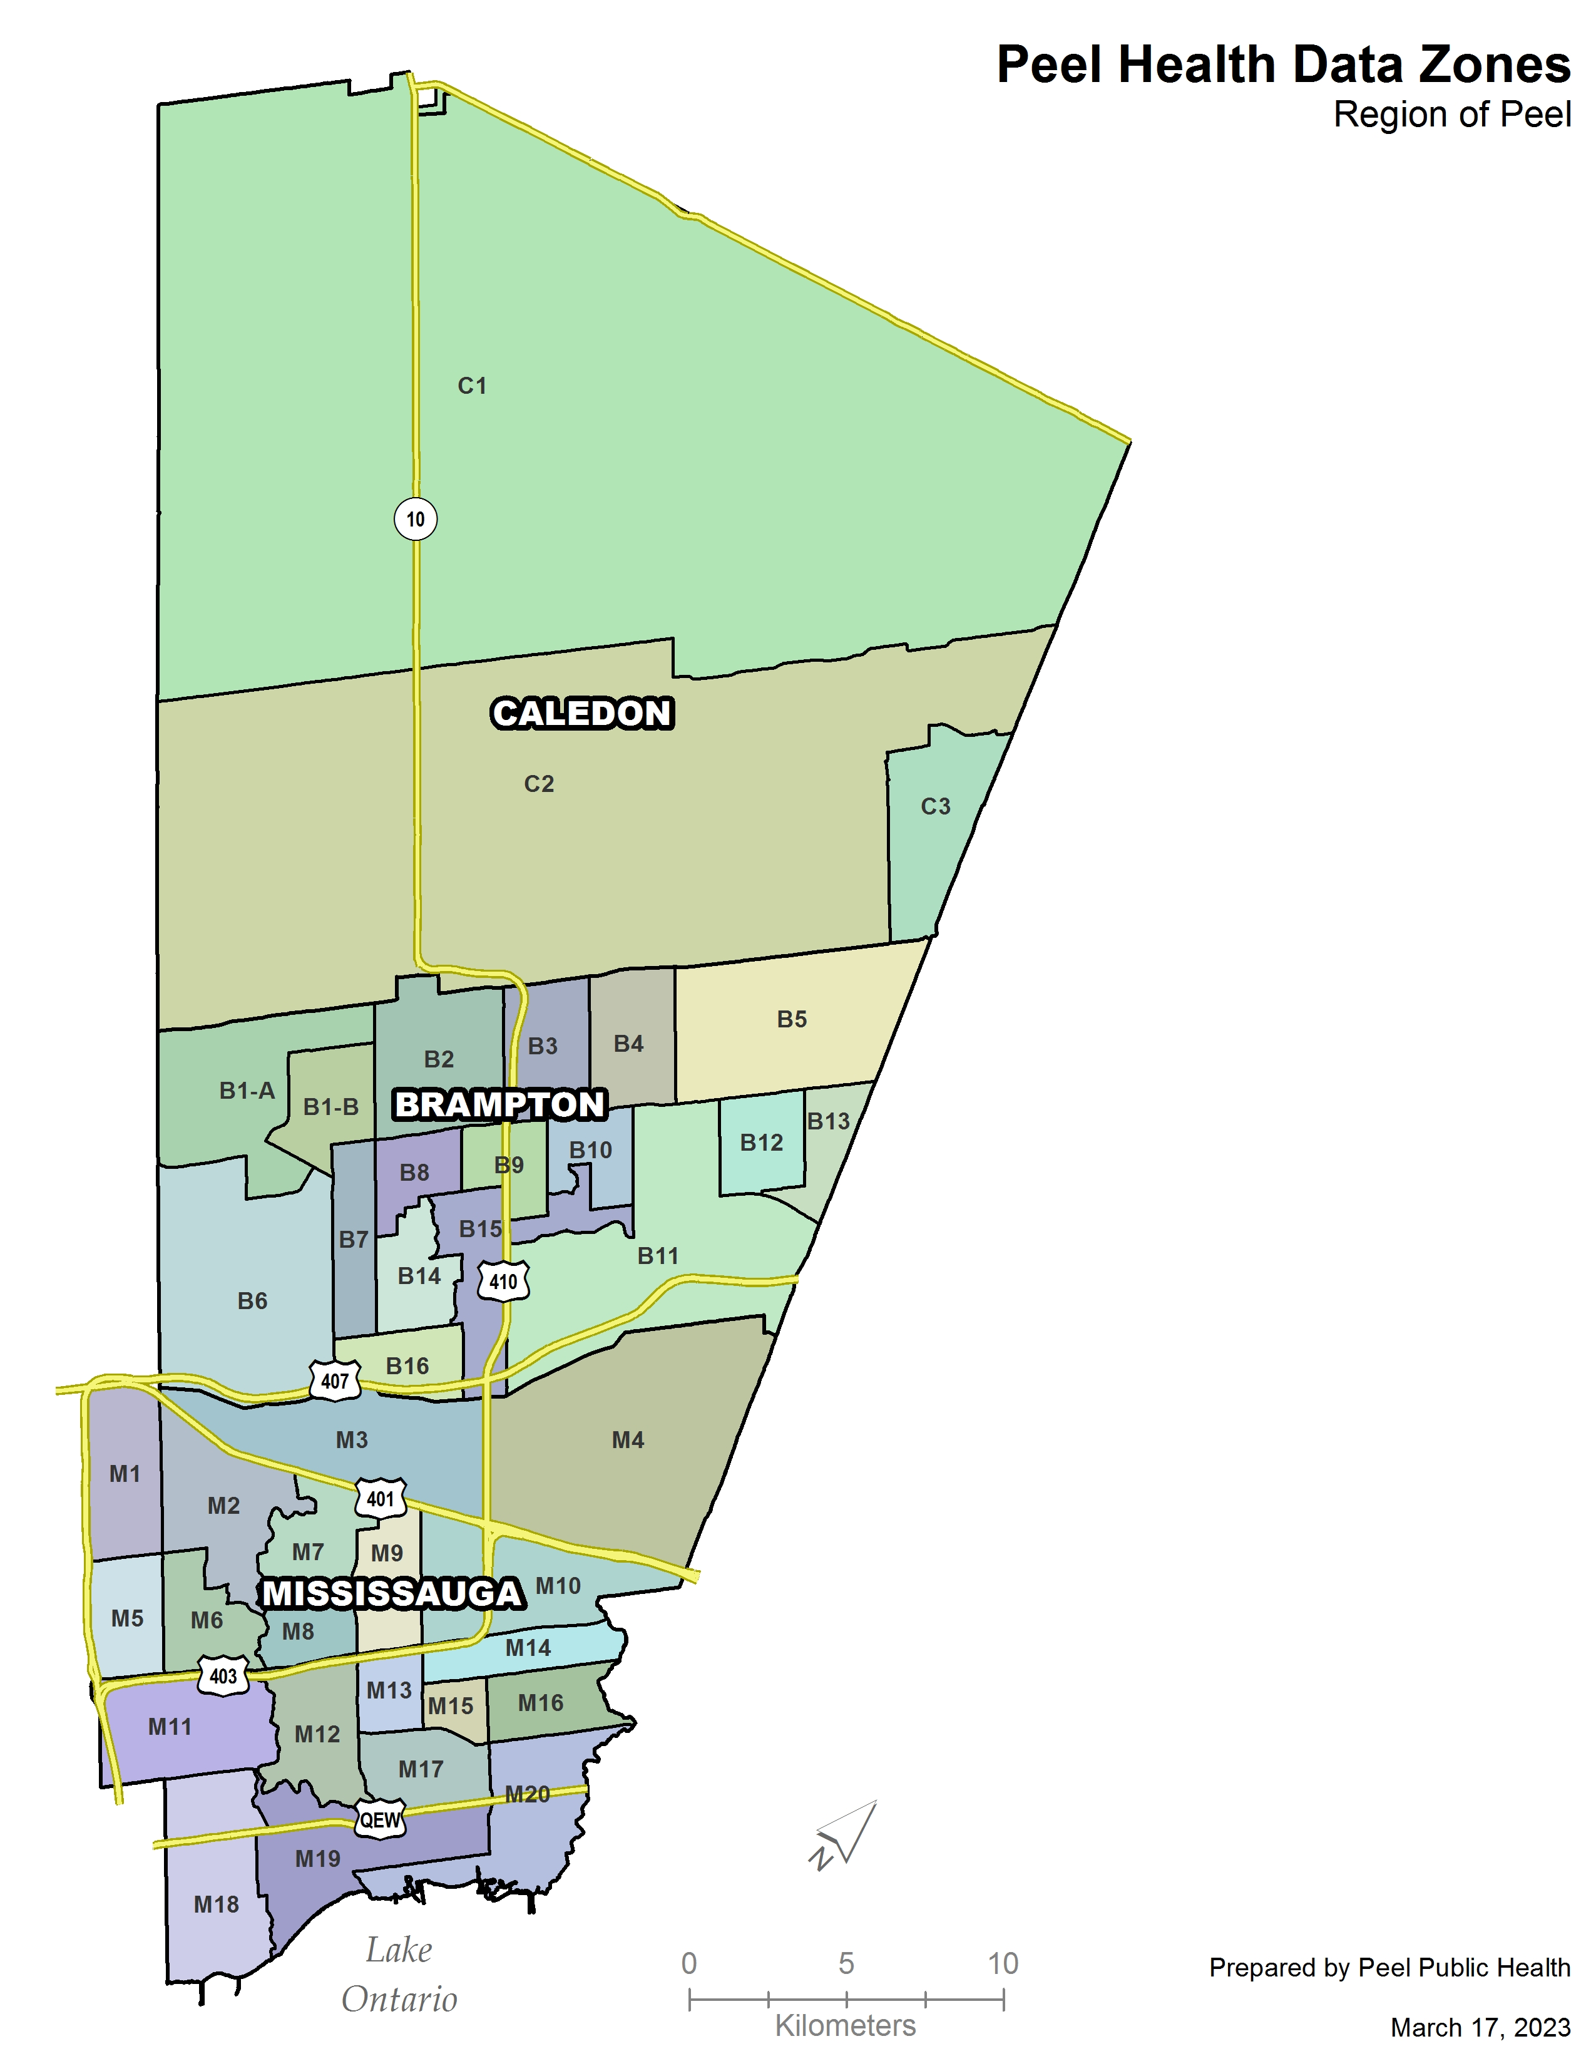
New Boundaries
40 Peel Health Data Zones
Average population: ~36,000
Built around the following variables:
Individuals living alone
Lone parent families
Low-income seniors
Recent immigrants
Housing in need of major repairs
High housing cost to income ratio
Low education attainment
High unemployment
Notes:
Data zones were aggregated from census tracts using the the results of the cluster and outlier analysis hot spot analysis SDOH composite scores, road network major water courses multiple listing service (MLS) neighbourhood boundaries (City of Ottawa combined physical and demographic characteristics to define boundaries and utilized MLS neighbourhood maps to help identify areas of common reference) and ortho-images
These zones shared a similar composite score and included census tracts that were flagged as significant hot or cold spots and omitted outliers. These zones were aligned with existing local boundaries based on information sourced from Google Maps and MLS, and respected natural and human-made boundaries.

Slide 11
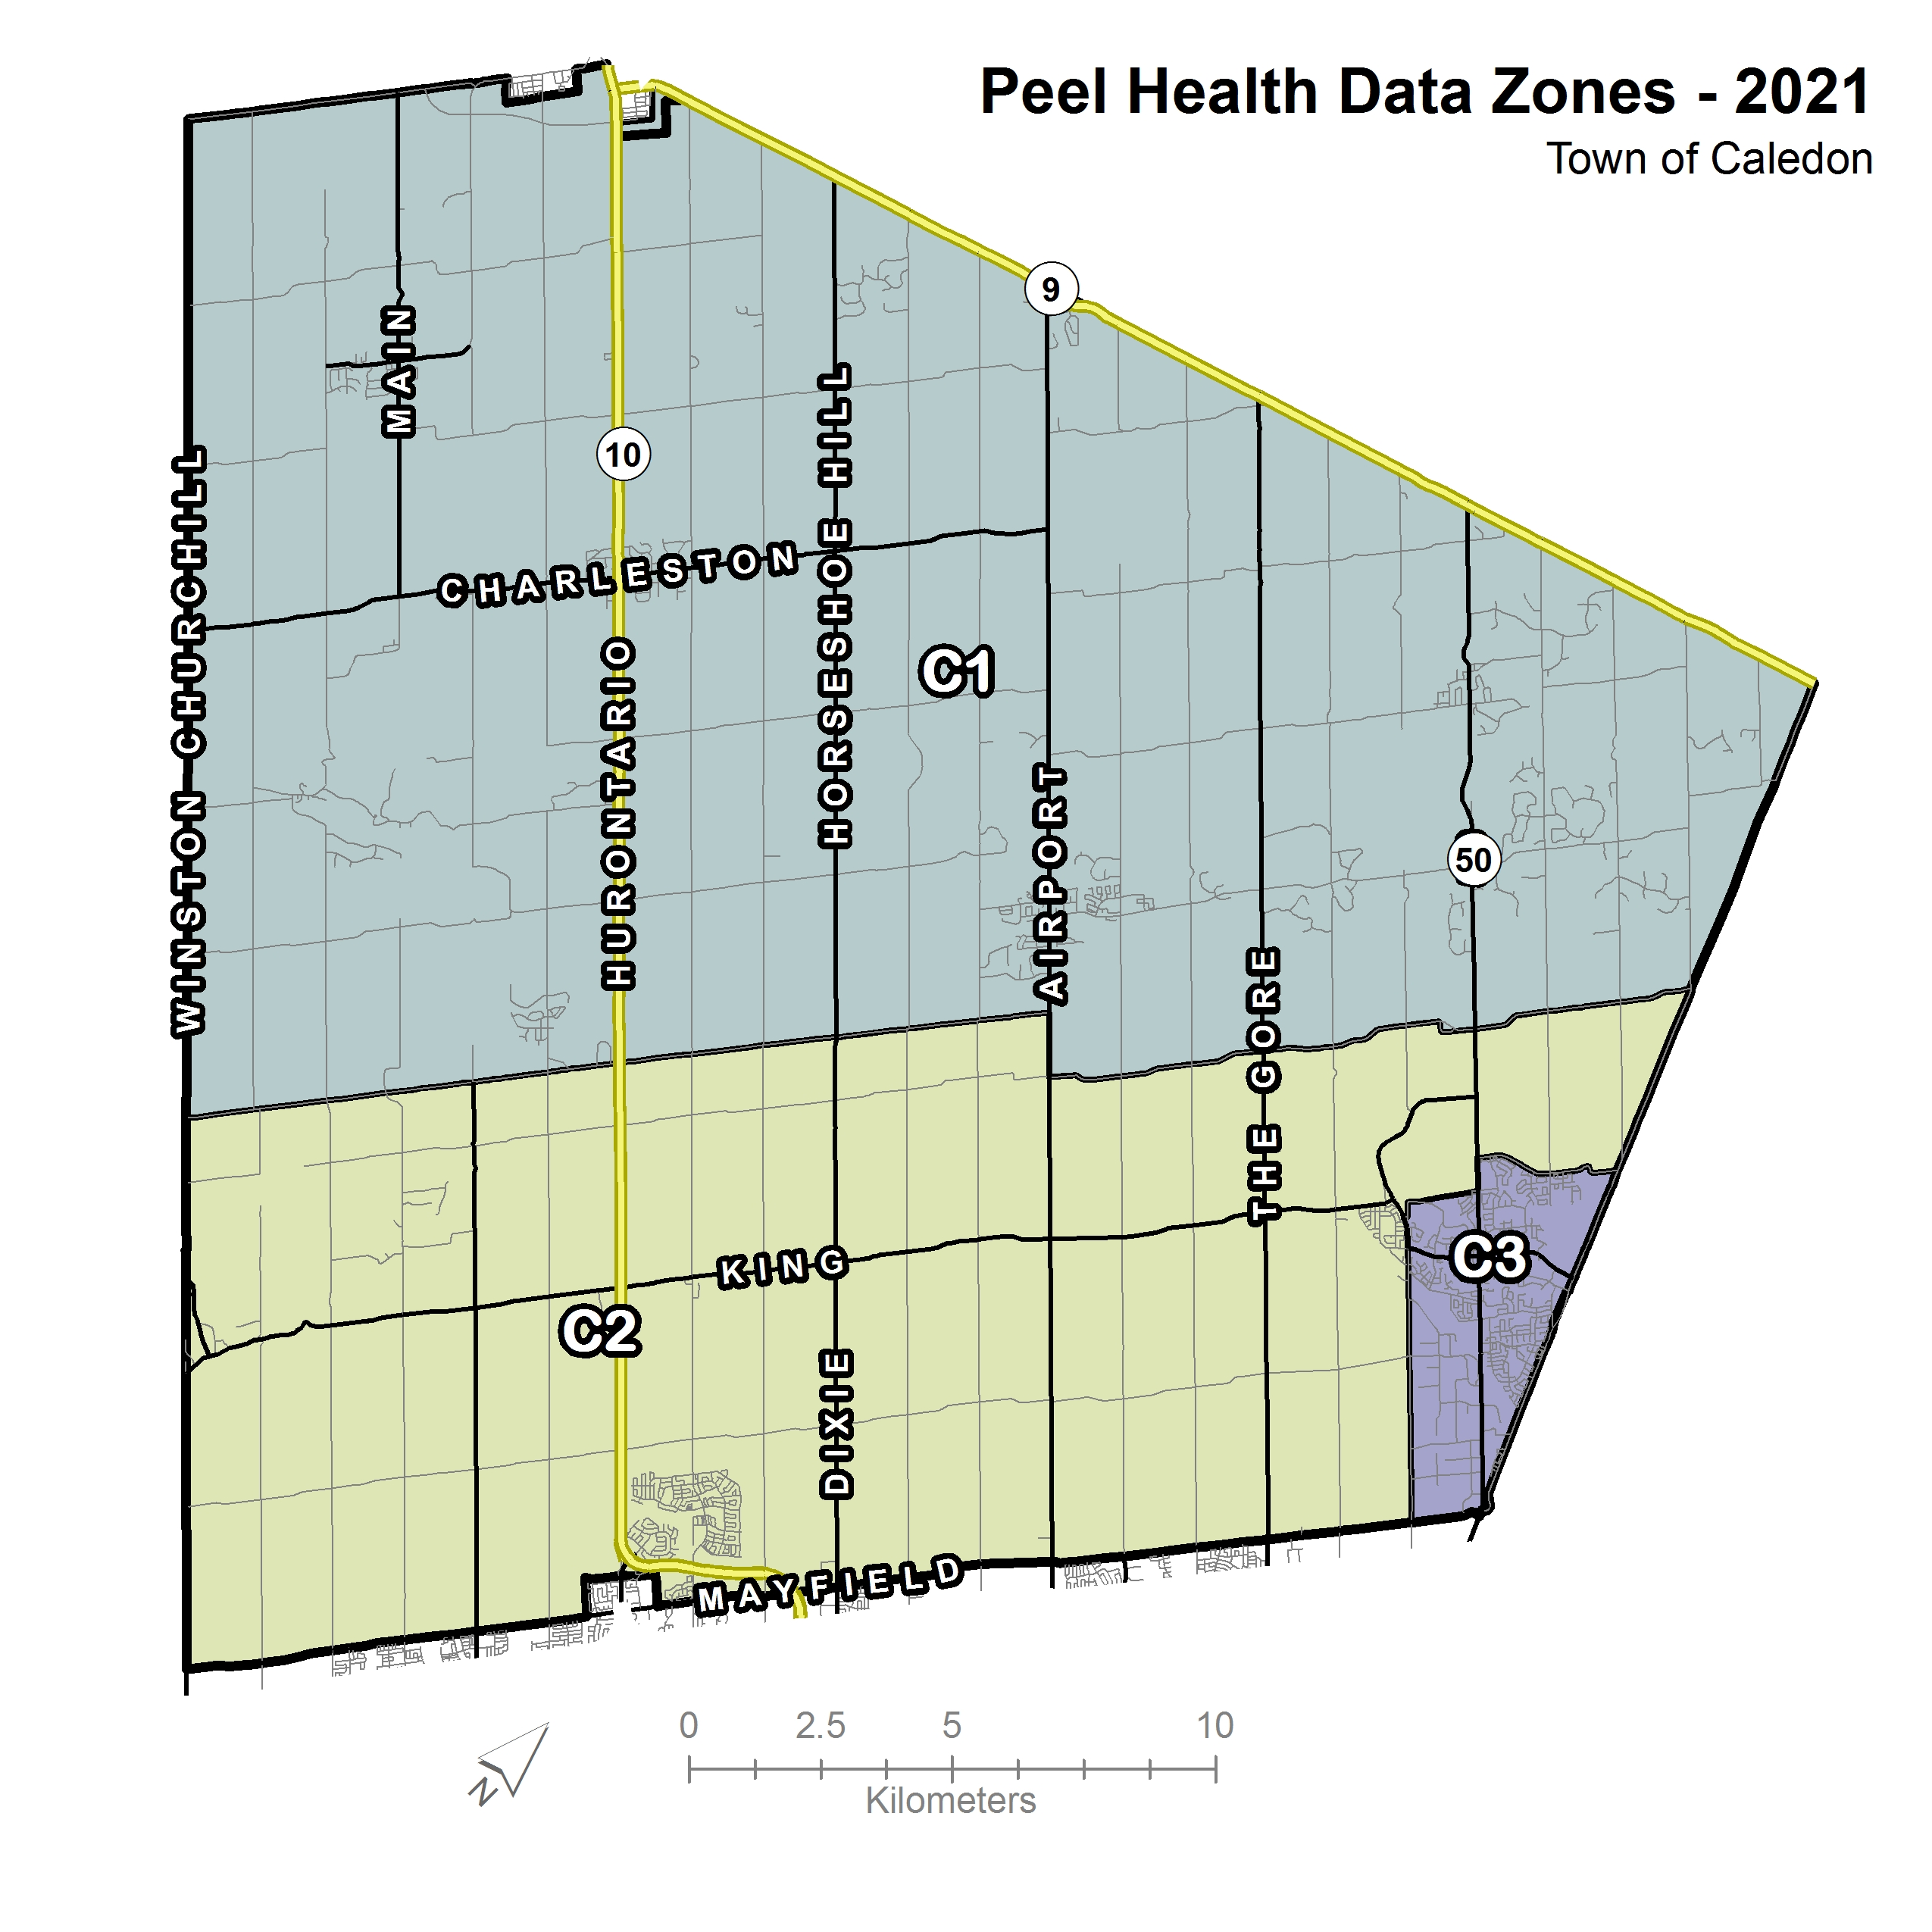
A Closer Look:
Caledon

Slide 12
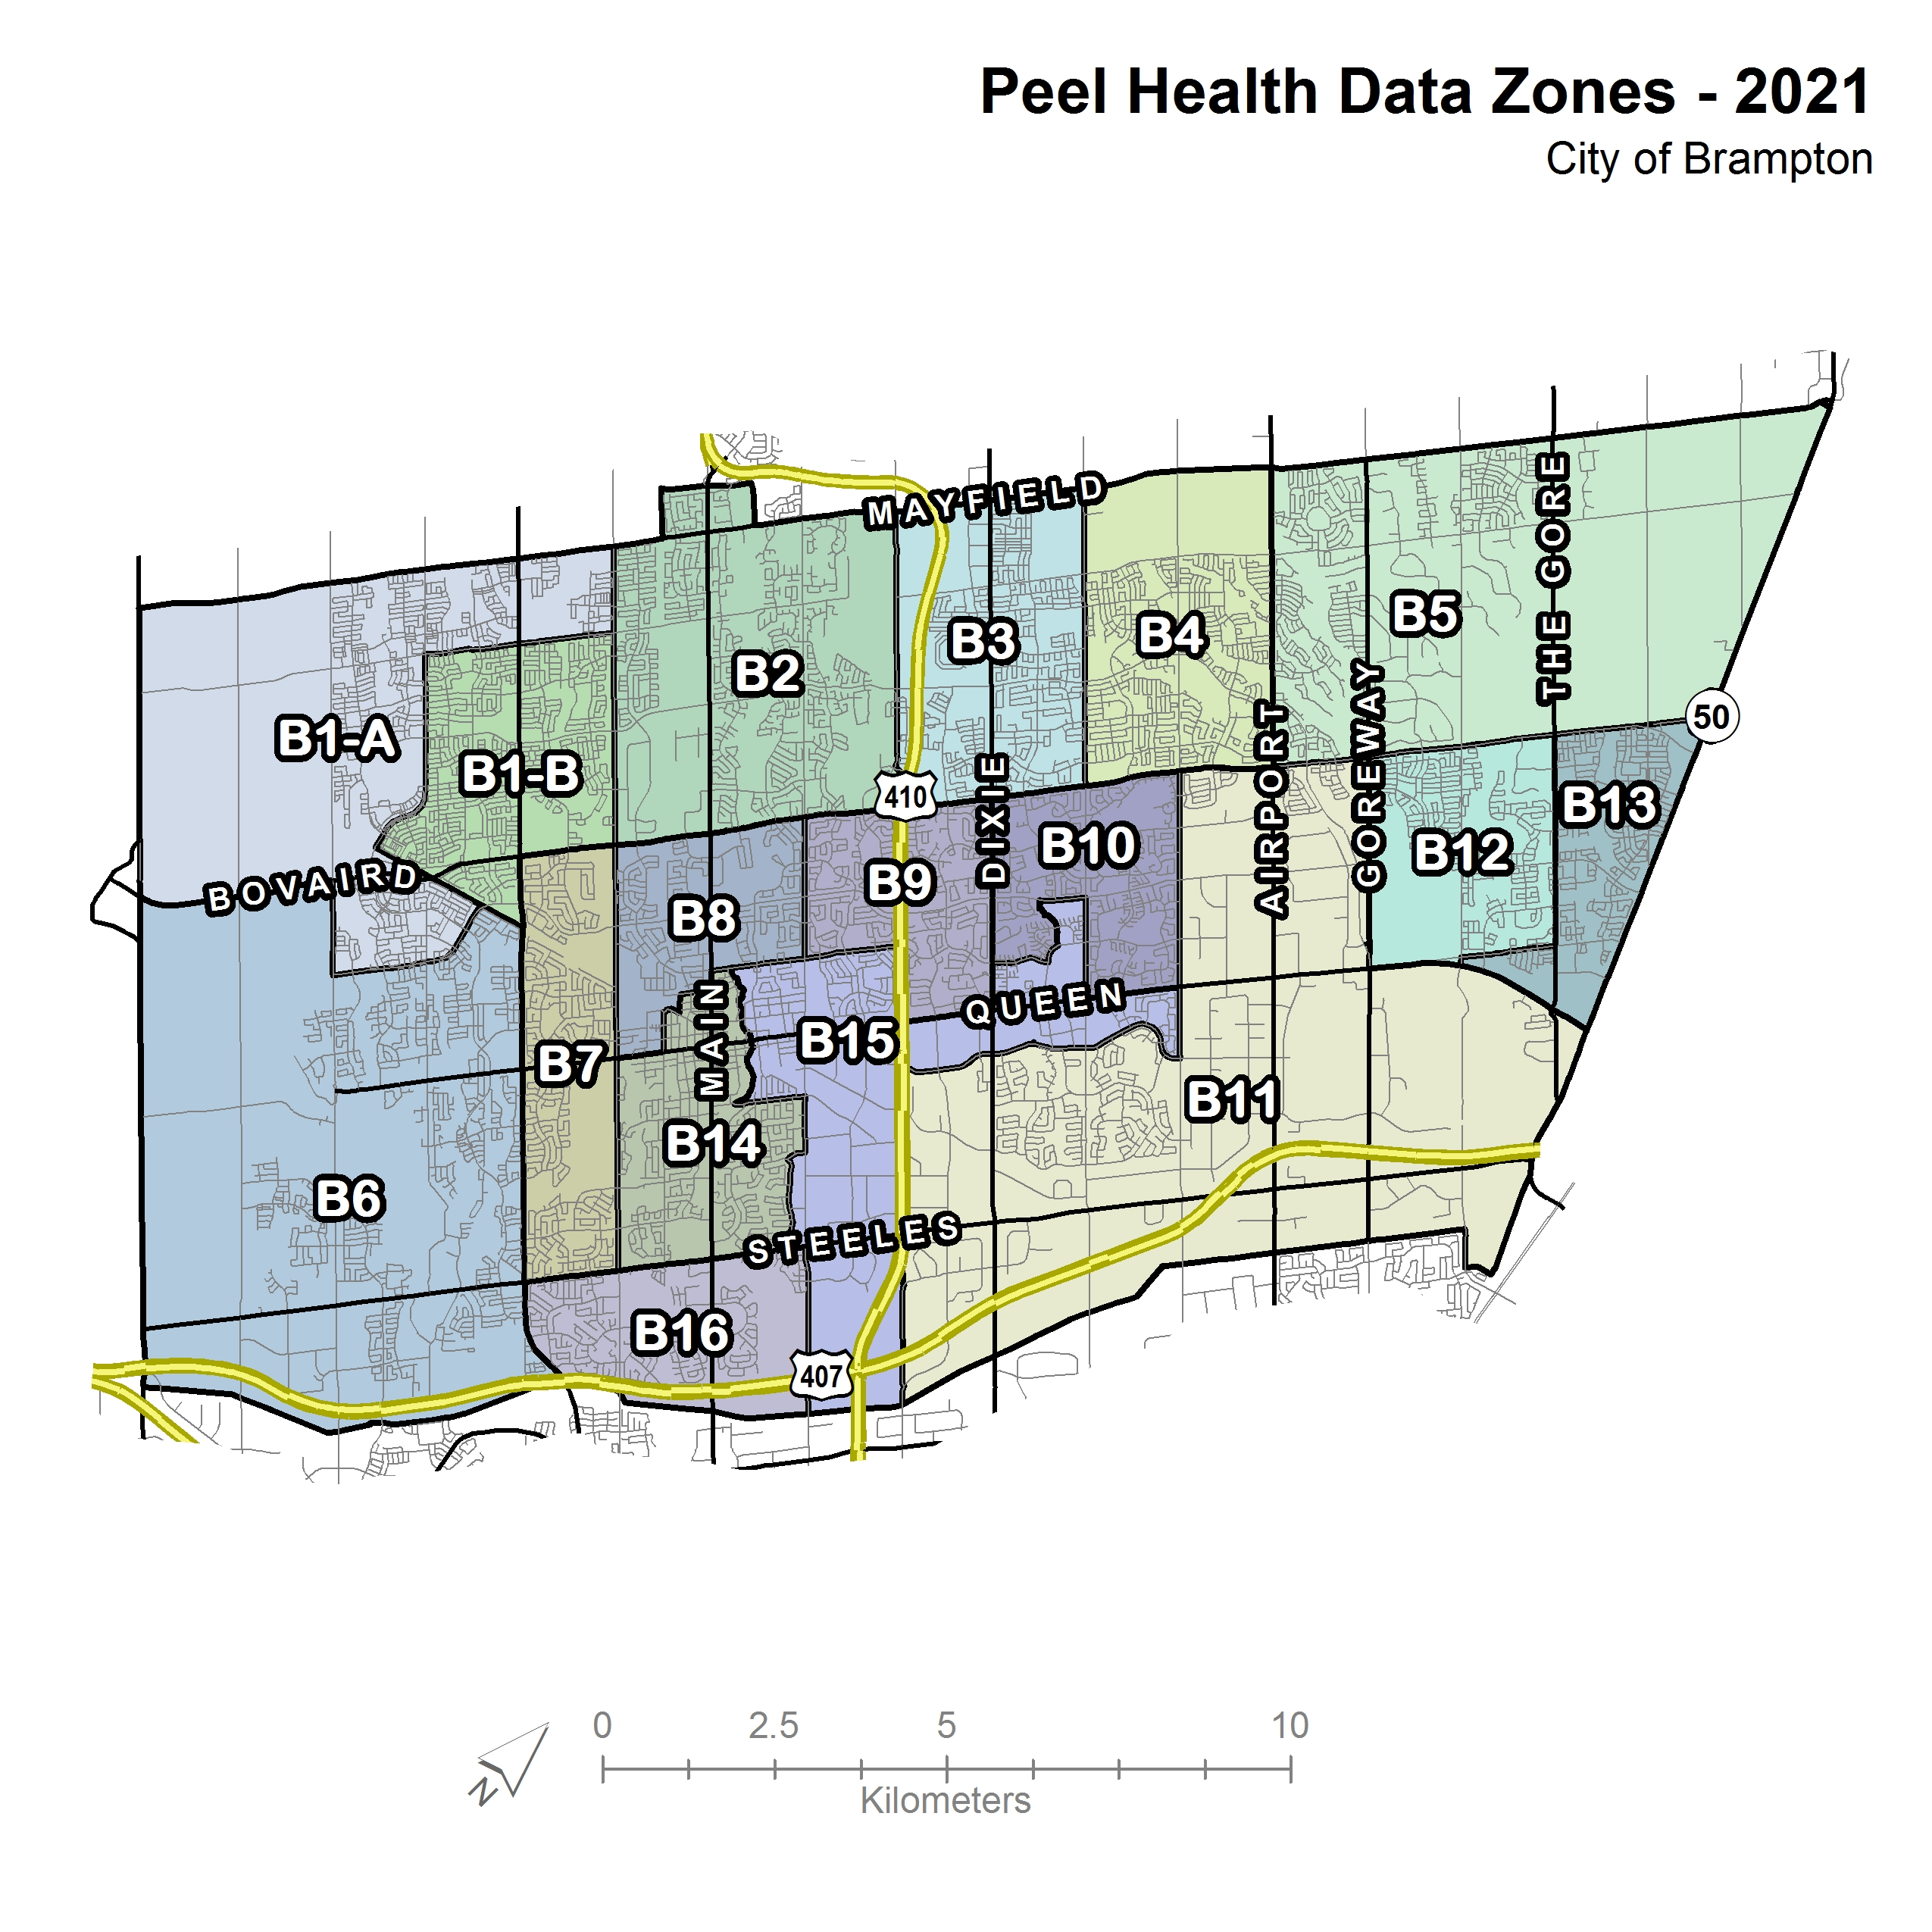
A Closer Look:
Brampton

Slide 13
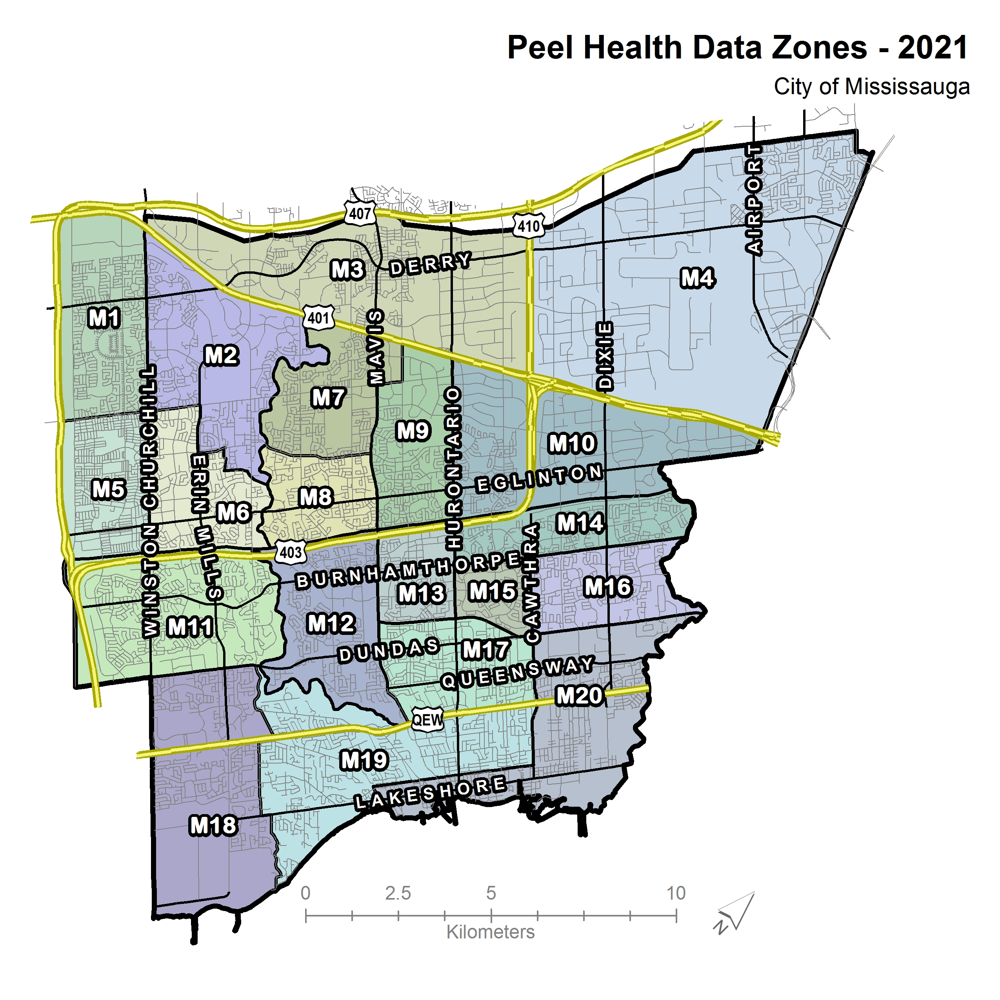
A Closer Look:
Mississauga
Notes:
.

Slide 14
2021 PHDZ Populations

Slide 15
Mississauga
New data zones revealed notable variations in select demographics.
PHDZ – Median Household Income, LIM-AT
M19 – $121,268, 6.1%
M5 – $86,742, 17.9%
M4 - $57,399, 35.0%
PHDZ - % recent immigrants, and knowledge of an official language
M5 - 22.2%, 3.1%
M4 - 20.2%, 5.5%
M19 - 5.0%, 1.5%

Slide 16
Limitations
MLS neighbourhood boundaries are not available for the Town of Caledon.
It is recognized within spatial science that as an aggregated area increases in size, the recognized variance of the characteristics of the population within the area declines (Jelinski and Wu 1996). The modifiable areal unit problem typifies this, reminding researchers that "the areal units (zonal objects) used in many geographical studies are arbitrary, modifiable, and subject to the whims and fancies of whoever is doing, or did, the aggregating."
Data zones (neighbourhoods) will on occasion violate the decision-making process to:
  Prevent high and low clusters and outliers from being grouped. This can be observed in a few census tracts that border the M19 data zone.
  Achieve a minimum population base of 20,000.

Slide 17
Conclusions
Though the exercise of defining neighbourhoods can never be free from error, a mixed method approach that accounts for variance within the social determinants respects barriers, incorporates local expertise, validates barriers and boundaries using ortho-images, and utilizes geospatial techniques to identify clusters and outliers. Hot spots help reduce potential errors when delineating human phenomenon that operate outside of spatial constraints.
Using this approach, 40 Peel Public Health Data Zones were identified. These will be used to better understand the health status of Peel’s residents at a community level to inform public health planning and program implementation and support the work of community partners.

Slide 18
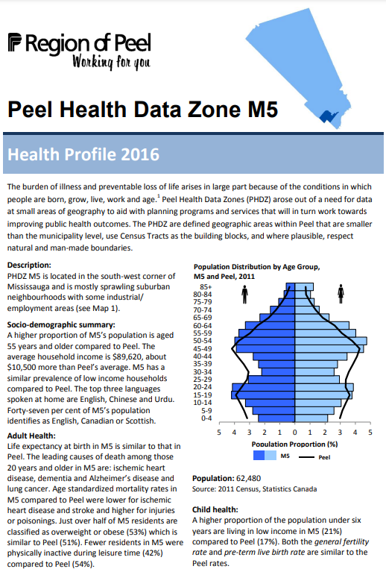
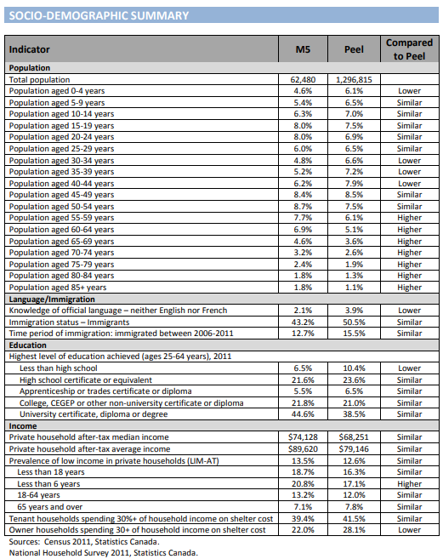

Slide 19
Demonstration

Slide 20
Future State
Step 1: Sociodemographics
Social and structural determinants of health
Build a common understanding of Peel’s context
Step 2: Health Data
Child Health: top 5 leading causes of mortality, birth rate, infant mortality rate, vulnerable on 1+ EDI domains
Adult Health: top 5 leading causes of mortality, life expectancy, health behaviours (e.g., smoking, drinking, physical activity, cancer screening) chronic disease incidence and prevalence

Slide 21
Q&A

