Slide 1


GIS in Public Health
Notes:
Good afternoon - Thank you for the introduction and for having me here today to talk to you about the GIS lit search. My name is Jane and I am the SLSP librarian situated at KLF&A Public Health. I have been incredibly fortunate to be the public health research librarian for eastern Ontario for the past 12 years, and also to work part time for the University of Alberta, Centre for Healthy Community and Policy, School of Public health for the past three years.

Slide 2

Background Info
Topic:
GIS in Public Health
Purpose:
Working 'living' document to be used to inform implementation of GIS by epidemiologists in Public Health across Ontario
Type of Search Required:
Literature Search
Type of Review being conducted:
TBD
Final Product?
TBD
Notes:
Today I’ve been invited to give you an overview of what has been done to date on the GIS literature search. I’ll give a quick overview of the what has been completed so far, and then ask a few questions around next steps for the team to consider and discuss offline. Last year I was asked to run a preliminary search to help inform a research question. The type of review required for this project is still undetermined and depending on what review type the team lands on, this will help inform next steps.

Slide 3
Draft Question:
­­­What are the general 'best practices' for geographic information systems (GIS) use in public health?
Concept | Inclusion | Exclusion
Geographic Information Systems (GIS) | Includes 'landscape epidemiology', medical topography, geo-mapping, etc.
Public Health/Population Health | Limited to public health as ‘organization’ or ‘population of interest’ (i.e., public health, community health, rural health, population surveillance, etc.) | Excludes public health specific programs or indicators under surveillance such as: infectious diseases, or public health programs/ interventions
Best Practices | Guidelines that outline expectations for file architecture, data flow, workflow, division of responsibilities, data privacy considerations, methods for collection of information, implementation practices, and/or data governance | Personal health records
Language | English language | Non-English language
Publication Date | 2017 – current | Pre-2017
Notes:
The draft question was – What are the general best practices for GIS use in public health. Below you can see the inclusion/exclusion criteria. This of course may change should the team want to expand or eliminate a concept. Presently, I’ve defined GIS as , …

Slide 4

Limitations/Challenges:
Searching for GIS + PUBLIC HEALTH too broad (10,000 + results)
Adding a 3rd concept helped narrow, but ‘best practice’ terms such as ‘measurement’ or ‘implementation’ of GIS in public health returned articles on public health interventions and evaluation of interventions (GIS mentioned as method but not subject)
To focus on GIS practices, terms such as ‘evaluation, meta-synthesis, program evaluation, and program development’ terminology were removed and instead narrow definition of ‘best practices’ was applied
Public Health/Population Health Concepts were limited to ‘organization’ or ‘population
Concept Map:
[((GIS + PUBLIC HEALTH/POPULATION HEALTH/EPPI) OR (PUBLIC HEALTH INFORMATICS)) + (PRIVACY OR WORK PROCESSESS OR GENERAL QUALITY TERMS)]
Notes:
I did encounter some limitations and challenges with this search.
Searching for GIS + PUBLIC HEALTH alone was too broad (10,000 + results). It required a third concept ‘best practice’ to narrow scope
Using terms synonymous with ‘measurement’ or ‘implementation’ returned articles on public health interventions and evaluation of interventions - These articles briefly mentioned USING GIS as a research method to collect the data but did not discuss best practices for implementing GIS in public health. Essentially, GIS was the method used, but not the subject of the article. I contemplated including any public health intervention that uses GIS as a method (as an example of how GIS is used in public health re: ‘implementation practice’) – but, this would include thousands of results. So at the time the decision was made to exclude articles using GIS as a methodology.
As mentioned Public Health/Population Health Concepts were limited to ‘organization’ or ‘population’ – I excluded public health specific programs or indicators such as infectious disease. Using specific programs and indicators made the results too large and unwieldy – i.e., included articles that mention using GIS to map disease spread and results of disease within a population, but again, not implementation of GIS as a practice)

Slide 5
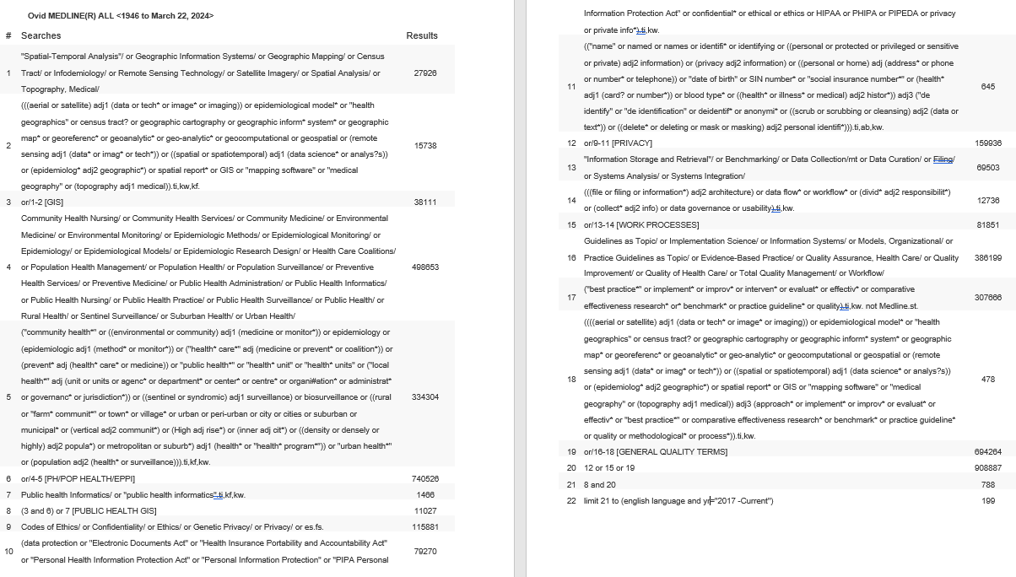
Notes:
This is a copy of the draft search strategy applied. It looks like a lot, but it is actually quite narrow in scope. After this meeting I will invite members of this team to the protocol to review and make notes on the protocol if you’d like, which includes a copy of this strategy. Since the initial intention was for a ‘living’ document, the search strategy automatically runs once a month and outputs any new research on the topic.

Slide 6

Work Completed to Date:
Narrow search of 4 databases (278 results)
Grey literature search test (10 targeted health organization websites)
University Catalogue (10 texts)
Environmental scan (12 GIS contacts)
Environmental Scan
Public Health Ontario
Specialist
ESRI Canada
British Columbia Geological Survey
Alberta Health Services
Technology and Innovation Alberta
GeoDiscover Alberta
Interactive Health Data Application Alberta Health
BCCDC
CDC
World Health Organization
Ministry of Health
Notes:
So what’s been done to date, a test search run in 4 databases (Medline, Embase, Environment Complete and Greenfile) for a small total of 278 results – some articles were on target such as Why Public Health Needs GIS: A Methodological Overview, but others were missed with this specific focus applied. Ten targeted websites were searched for grey literature; 1 university catalogue for texts/guides and an environmental scan reaching out to 12 organizations listed on the slide requesting any internal guidelines they could share. The response rate from the environmental scan was 50% and of the 6 who responded, only 1 - the contact from the Interactive Health Data Application Alberta Health provided a document. ESRI responded with an offering for consultation support (for a fee).
The remaining responses consisted of positive feedback regarding the project, an interest in the final product, but nothing to add or report.

Slide 7

Next steps…
Will the team conduct a review? If yes, what type of review? Depending on the type of review, the following may be considered: Adjustment of search strategy
    Output of results (software)
    Methodology for screening (percentage of agreement / IRR)
    Decision to appraise
What is the final product? Will it be published?
Finalize grey literature search
Expand environmental scan
Recommendation for citation chaining / reference checking of relevant articles identified by team to ensure coverage of relevant materials
Notes:
Going forward, if the team decides to conduct a review, first consideration will be, what type of review? The type of review often depends on the final product you are hoping to achieve and/or the time/resources you have.
Depending on the type of review the team is considering, the search can be altered accordingly – i.e., should the team choose to conduct a living systematic review or a living rapid review, the search should be adapted to be more sensitive and pick up a larger portion of the research for inclusivity.
If the search remains limited, the final product may look more like an annotated bibliography of recommended resources.
I would still suggest a full grey literature search and citation chaining to accompany the research and expanding the environmental scan. As mentioned I will invite staff to review the draft protocol with all this information collected. If you decide to go forward with the review, I’m happy to assist and provide support. Any questions before I sign off?

