Slide 1
Geospatial Analysis of Diabetes Prevalence in Peel Region
APHEO Presentation
March 25th, 2026
Hridita Das
Notes:
Good morning, and thank you for the opportunity to present today. My name is Hridita Das, and I will be presenting my results for a Geospatial Analysis of Diabetes Prevalence in the Peel Region

Slide 2



Unique Features of Peel Region
      Built Environment
      Most neighbourhoods in Peel are low‑walkability.
      Large parts of Brampton and Caledon have no frequent transit.
      Development
      Brampton and Caledon has had high population growth from 2016-2021, due to new homes being built in the suburbs (Region of Peel, 2021).
      Peel is dominated by low-density, car-dependent, suburban development (Region of Peel, 2021).
      83% of residents commute by car, while only a small share walk or cycle (Region of Peel, 2021).
      Demographic
      51.8% of residents are immigrants, and 69% identify with a racialized group (Region of Peel, 2021).
      South Asian is the most identified racialized group within all 3 cities.
Notes:
To begin, it is important to situate Peel within its broader geographic and demographic context. Peel is characterized by a built environment that is overwhelmingly suburban, low‑density, and auto‑oriented. Much of Brampton and northern Caledon lacks frequent transit service, and overall walkability is low.
From a development perspective, Brampton and Caledon have experienced rapid population growth, driven by extensive greenfield construction and suburban expansion in the 2016–2021 period. Low‑density development has reinforced auto‑dependence; indeed, 83% of Peel residents commute by car, while relatively few engage in active transportation modes.
Demographically, Peel is one of the most diverse regions in Canada. Over half of residents are immigrants, and nearly 70% identify with a racialized group. South Asian communities form the largest visible minority group across all three municipalities. These unique attributes shape both the distribution of population health outcomes and the built environment in which those outcomes occur.

Slide 3
Municipal Differences in Risk of Type 2 Diabetes
The age-standardized rate for diabetes is 15.5% for Peel, 9.8% for Ontario and 10% for Canada.
Brampton
Very high diabetes rates across some census tracts - over 20% in some areas
Brampton and Mississauga have higher diabetes rates clustering in lower‑income and lower‑education areas.
Mississauga
More mixed SES; high-diabetes clusters in central/northeast areas.
High diabetes in low-income and low-education areas.
Caledon
Rural, low-density, affluent; longest travel distances but lowest diabetes prevalence.
High SES, low diabetes.
Notes:
Disease burden is high and uneven in the Peel Region​. The age-standardized rate for diabetes is 15.5% for Peel, 9.8% for Ontario and 10% for Canada.
In Brampton, several census tracts show extremely high diabetes prevalence—exceeding 20% in some areas. These clusters often overlap with lower‑income and lower‑education neighbourhoods.
Mississauga, by contrast, exhibits greater variability. High‑prevalence areas tend to concentrate in central and northeastern neighbourhoods, which also exhibit lower SES profiles.
Caledon, with its rural character, higher SES, and dispersed population, consistently shows the lowest diabetes prevalence.
This heterogeneity underscores the need for models that respect municipal boundaries rather than treating Peel as a homogeneous region.

Slide 4
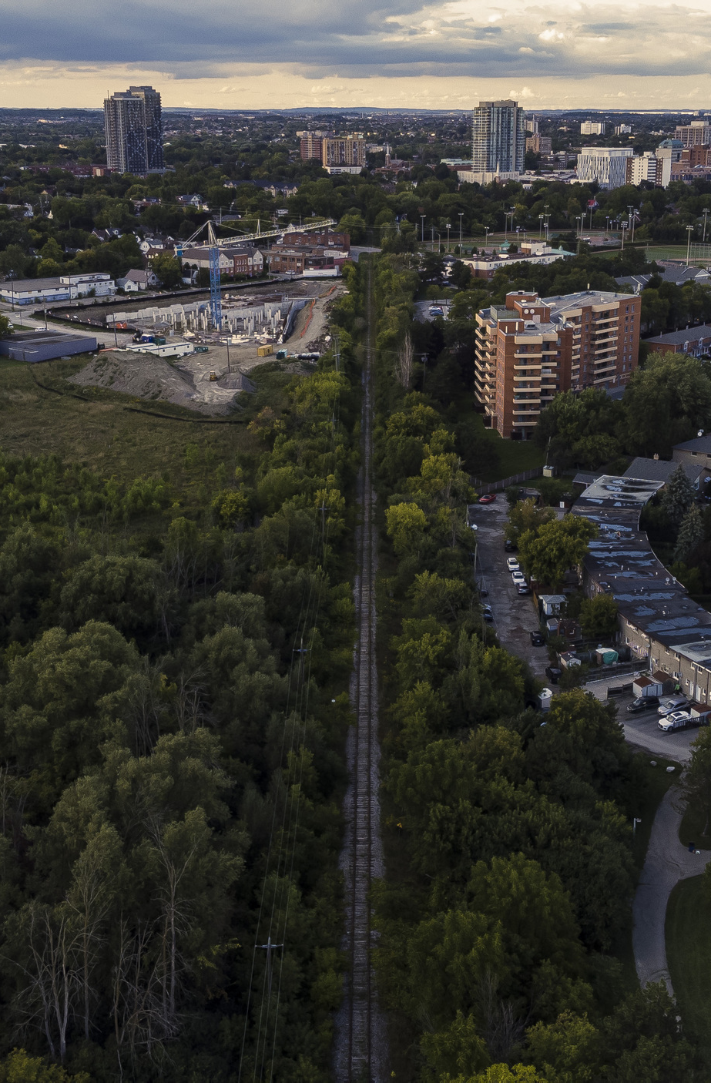
Research Objectives
1
Provide a neighborhood-level overview of what shapes diabetes rates in the Peel Region
2
Identify factors associated with diabetes prevalence at the municipal level
3
Explore how the cities in Peel differ from one another in diabetes prevalence
Notes:
First, to provide a neighbourhood‑level overview of the factors shaping diabetes prevalence in Peel.
Second, to identify key predictors of diabetes within each municipality.
And third is to explore how these cities in Peel differ from one another in diabetes prevalnce.

Slide 5
Variable Selection
Socio-Economic
ON-Marginalization Index Resources*
ON-Marginalization Index Racialized Newcomer*
% low-income
% low education (with high school diploma or less)
% Core housing need
% of immigrants (recent and long‑term)
% South Asian visible minority
% Black visible minority
% of households reporting food insecurity
Health Behavior
% Smoking frequency
% Heavy alcohol consumption
% with access to primary care (regular provider)
Built and Food Environment
Peel Walkability Index
Heat Vulnerability Index – Exposure**
Fast food density & proximity measure
Healthy food density & proximity measures
Food store density & proximity measures
Period of Construction (Before 1960, After 1991)
*ON-Marg Index Resources includes low-income, low education, unemployment, core housing need measures
*ON-Marg Index Racialized Newcomer includes recent immigration (2016-present), any visible minority ethnicity
**HVI Exposure includes: annual maximum mean warm-season land surface temperature; percent tree canopy coverage; mean greenest pixel
Notes:
We assembled a comprehensive set of variables spanning socio‑economic conditions, built and food environment measures, and health behaviour indicators.
These included:
ON‑Marg indices (Resources and Racialized Newcomer dimensions)
Walkability
HVI Exposure
Food environment measures
Period of construction
Smoking and alcohol consumption
Many variables were excluded during diagnostics due to multicollinearity or limited explanatory contribution. The remaining predictors reflect both theoretical relevance and statistical performance.

Slide 6
Data Preparation & Cleaning
Harmonize all variables to the 2016 census tract level
  Mississauga: 136 CTs
  Brampton & Caledon: 109 CTs
Variables were standardized through z-scoring method
Data Sources
Socio-Economic
Health Behaviour
Built and Food Environment
Outcome Variable
Canadian Census 2021
Market Basket Measure
Canadian Community Health Survey 2021 (Environics)
Statistics Canada – Retail Food Statistics
Peel Walkability Composite Index
Heat Vulnerability Index
ICES Chronic Disease Data 2021
Notes:
We harmonized data from multiple sources, including the 2021 Census, the Market Basket Measure, CCHS, ICES chronic disease data, and several Peel‑specific composite indices.
All variables were aligned to the 2016 census tract boundaries, producing a dataset of 136 tracts for Mississauga and 109 for Brampton–Caledon.
Predictors were standardized using z‑scores, which enabled cross‑variable comparability, especially for composite indices such as ON‑MARG and HVI Exposure.

Slide 7
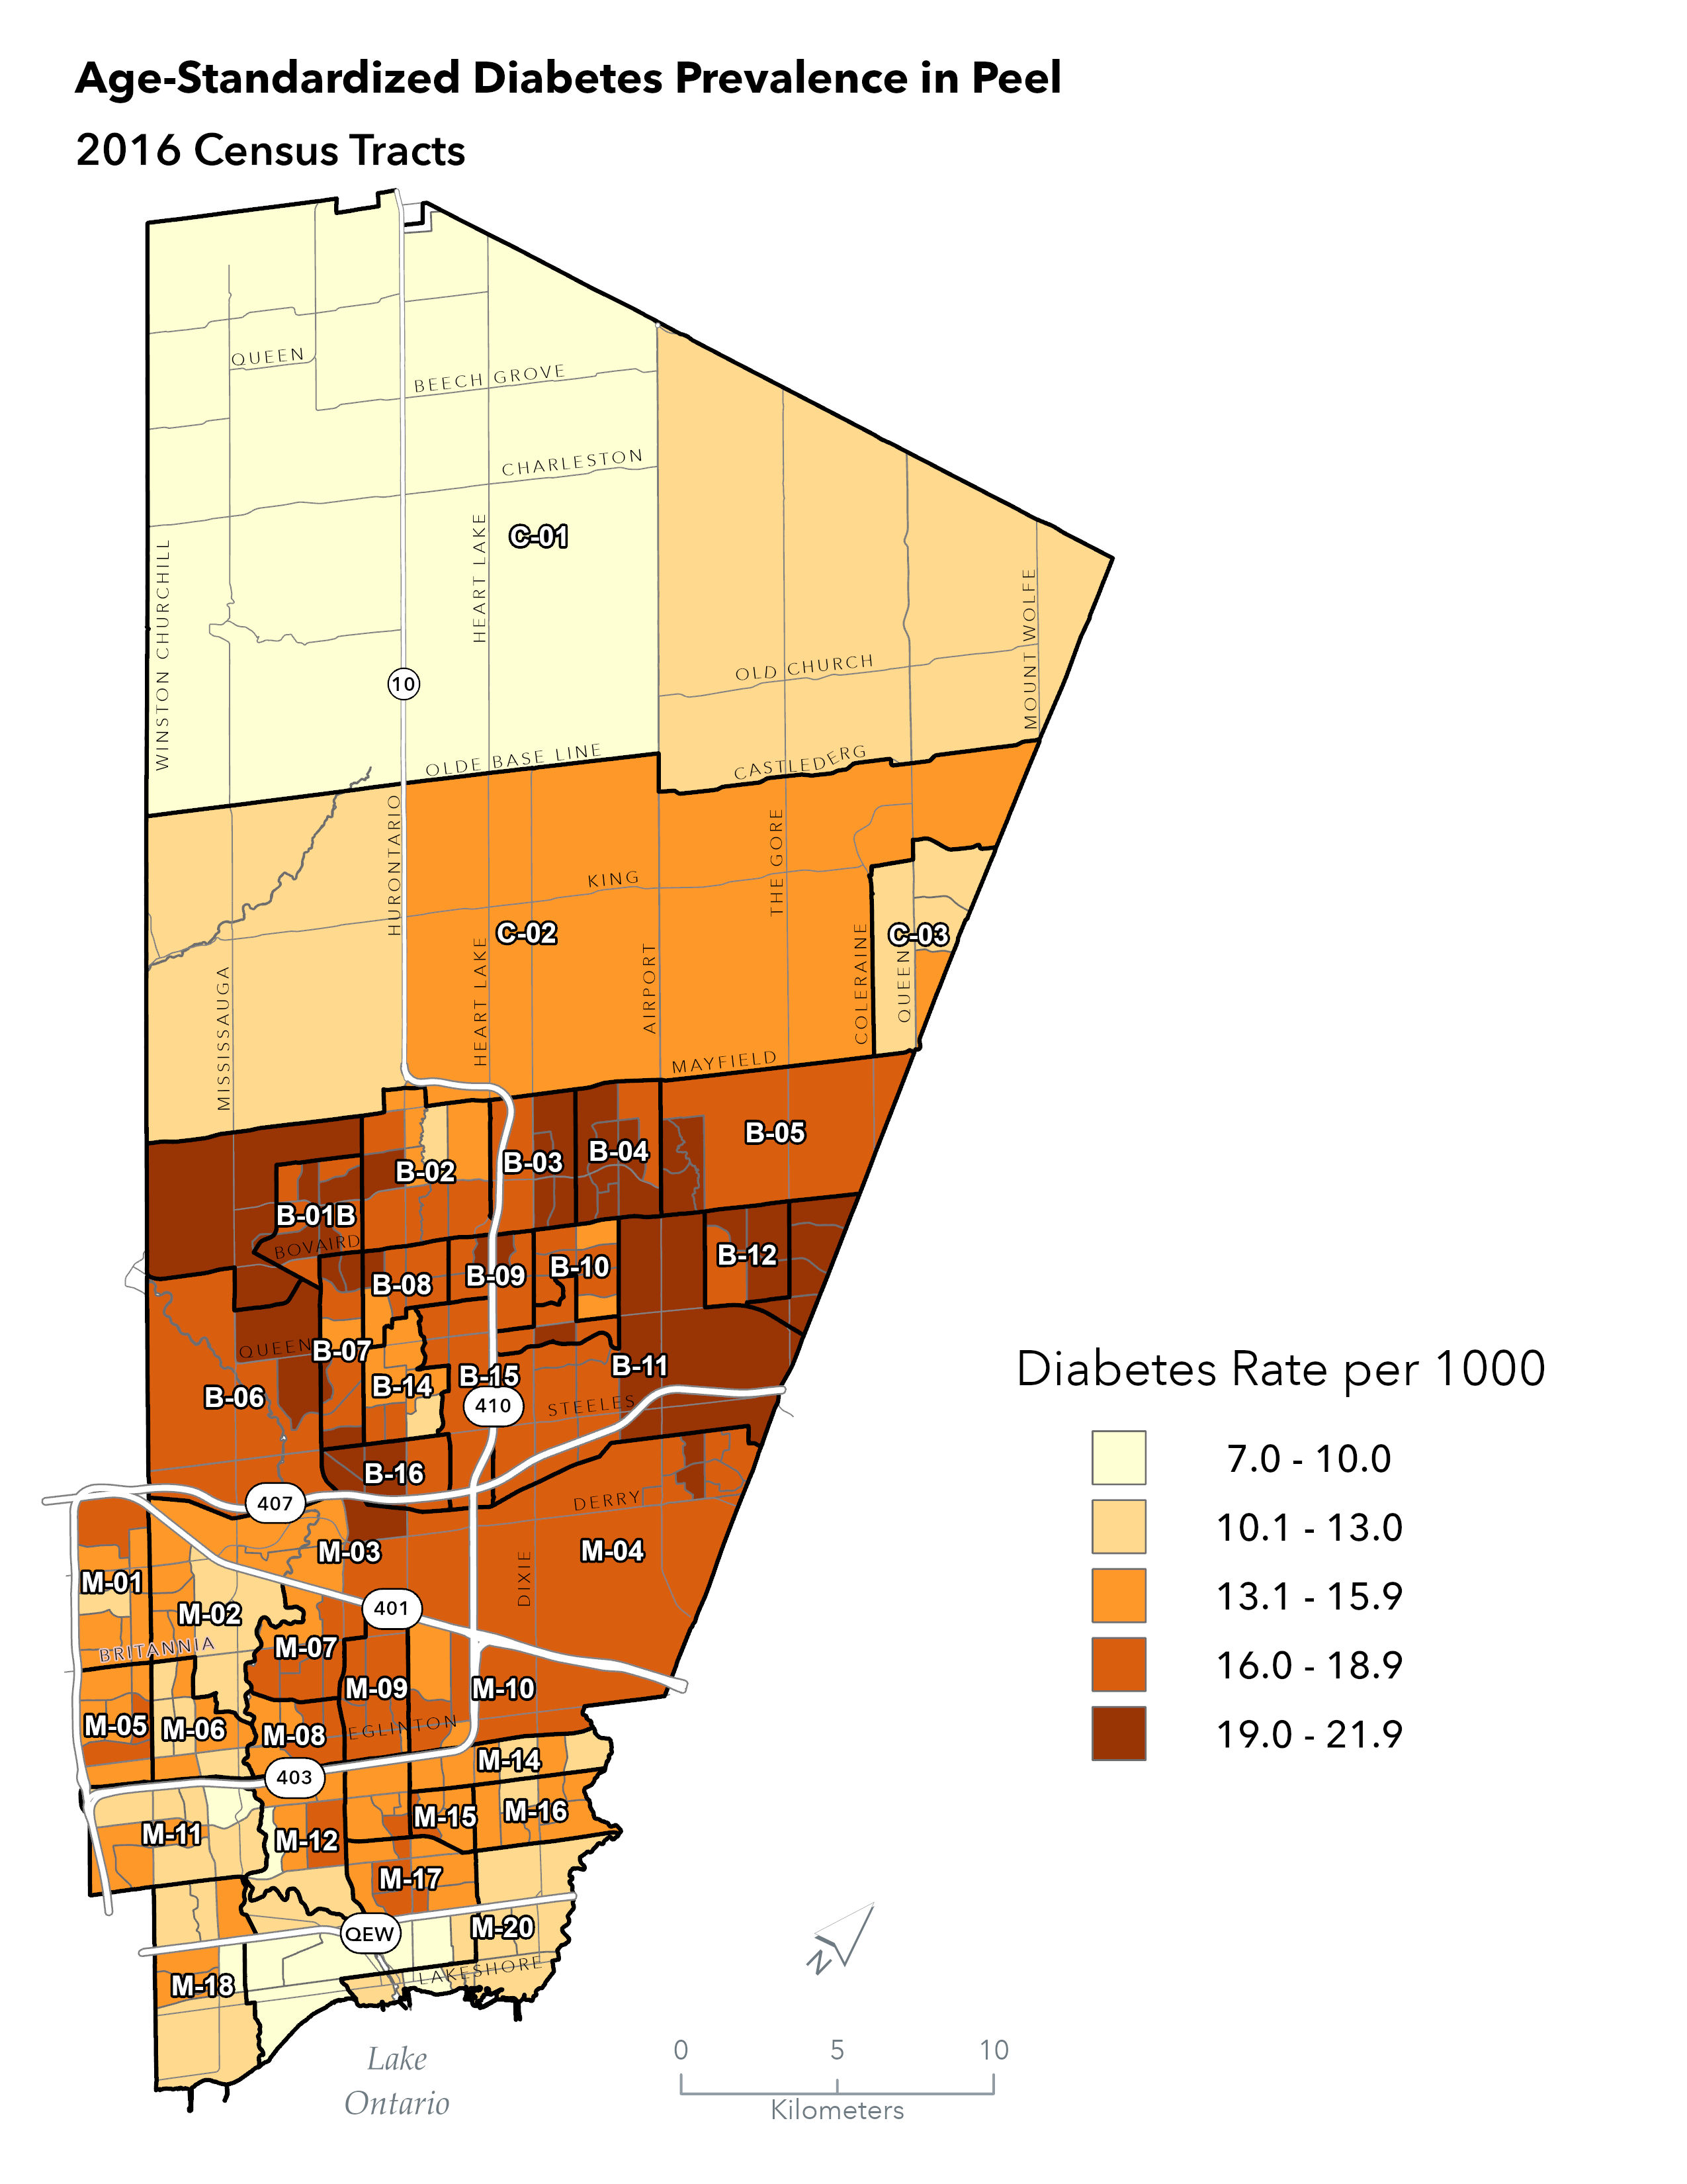
Diabetes Rates in Peel Region
Lower prevalence is concentrated in the less densely populated northern tracts.
Higher prevalence appears concentrated in the southern urbanized tracts, with multiple CTs significantly above the regional average.
Notes:
Diabetes prevalence varies widely across Peel. We see lower rates in the northern, less urban portions of Caledon and higher rates in the denser, more urbanized southern tracts.

Slide 8
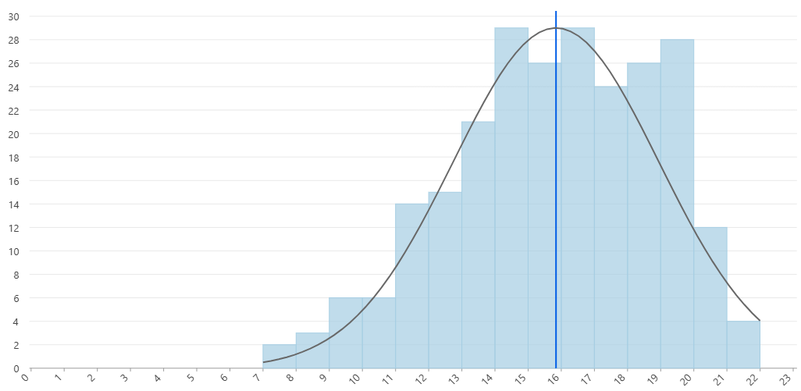
Diabetes Rates in Peel Region
Distribution of Diabetes Prevalence
Greater number of CTs with higher-than-average diabetes prevalence rate
Count of Census Tracts
Distribution is slightly skewed to the left
Age-Standardized Diabetes Rate (per 1000)
Mean = 15.78
Notes:
The distribution is slightly left‑skewed, with many tracts exceeding the regional mean of approximately 15.8 cases per 1,000.

Slide 9
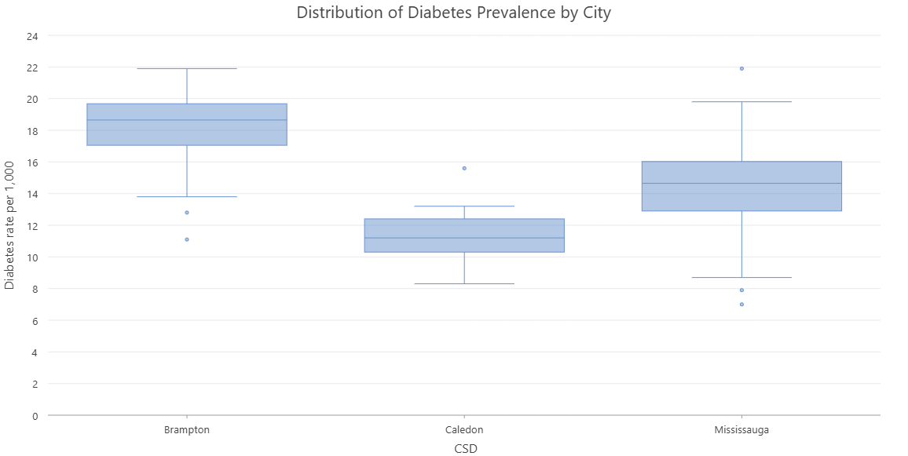
Diabetes Rates in Peel Region
Distribution of Diabetes Prevalence by City
Brampton has the highest prevalence rates
Mississauga has the highest variance
Diabetes Rate (per 1,000)
Caledon has the lowest prevalence rates
Notes:
When broken down by municipality, Caledon remains the lowest, Brampton the highest, and Mississauga exhibits the greatest variance, reflecting its mixed urban development patterns and diverse population structure.

Slide 10
Methods
Diabetes prevalence was not explained well through a Peel model
Peel Model
245 CTs
Brampton-Caledon Model
109 CTs
Mississauga Model
136 CTs
Notes:
Initial attempts to model diabetes prevalence using all of Peel were unsuccessful. No Peel‑wide linear or geographically weighted regression models met diagnostic criteria. This indicated meaningful structural differences between municipalities that could not be captured in a single pooled model.

Slide 11
Methods
No passing linear regression models. Population structures for 3 municipalities very different.
Diabetes prevalence was not explained well through a Peel model
Peel Model
245 CTs
Brampton-Caledon Model
109 CTs
Mississauga Model
136 CTs
Notes:
No Peel‑wide linear or geographically weighted regression models met diagnostic criteria. This indicated meaningful structural differences between municipalities that could not be captured in a single pooled model.

Slide 12
Methods
No passing linear regression models. Population structures for 3 municipalities very different.
Diabetes prevalence was not explained well through a Peel model
Peel Model
245 CTs
Brampton-Caledon Model
109 CTs
Mississauga Model
136 CTs
Brampton and Caledon share a border.
More statistical power with larger sample.
Similar emerging development in 2 cities.
Notes:
Brampton and Caledon were subsequently modelled together due to their shared border, demographic similarities, rapid suburban expansion, and the advantage of increased statistical power relative to modelling each separately.

Slide 13
Methods
Model Type: Generalized Linear Regression (GLR)
Six Diagnostic Checks for GLR
Check | Question
1. Variable Usefulness | Are variables helping the model?
2. Expected Relationships | Do the signs make sense?
3. Redundancy (VIF) | Are variables duplicates?
4. Model Bias (Jarque–Bera) | Do the residuals follow a normal distribution?
5. Spatial Autocorrelation of the Residuals | Are model residuals spatially clustered?
6. Model Strength | How well does the model explain outcome?
Notes:
We assessed model validity using six standard diagnostic criteria: variable usefulness, expected relationships, multicollinearity, normality of residuals, spatial autocorrelation, and overall model strength.
All final models—Mississauga and Brampton–Caledon—passed these diagnostics, showing strong explanatory power, normally distributed residuals, and no evidence of spatial clustering in the residuals.
All analysis is completed through Arc GIS pro

Slide 14
Mississauga

Slide 15
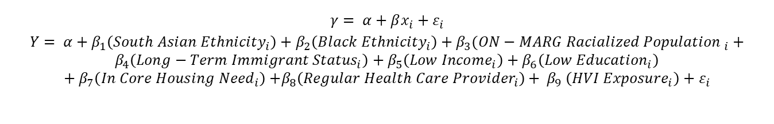
Mississauga Model
$$γ= α+βx_{i}+ε_{i}$$
$$Y= α+β_{1}\left({South Asian Ethnicity}_{i}\right)+β_{2}\left({Black Ethnicity}_{i}\right)+β_{3}({ON−MARG Racialized Population }_{i}+ \\ β_{4}\left({Long−Term Immigrant Status}_{i}\right)+β_{5}\left({Low Income}_{i}\right)+β_{6}\left({Low Education}_{i}\right)+β_{7}\left({In Core Housing Need}_{i}\right){+β_{8}\left({Regular Health Care Provider}_{i}\right)+ β}_{9}\left({HVI Exposure}_{i}\right)+ε_{i}$$
Metric | Value | Interpretation
Adjusted R² | 0.874 | Strong explanatory power
AICc | 374.1 | Good model fit
Spatial autocorrelation | p > 0.05 | Residuals are spatially random
Joint F/Wald tests | p < 0.001 | Model significant
Koenker BP | 0.704 | No heteroskedasticity
Jarque–Bera | 0.884 | Residuals normal
Highest VIF | 7.35 | Multicollinearity between: Low-income & Core Housing Need & ON-MARG Racialized Newcomers
Notes:
Turning to Mississauga, the model demonstrates strong explanatory power, with an adjusted R² of 0.87.
Key predictors included:
ON‑MARG Racialized Newcomers
Low education
Long‑term immigrant status
Core housing need
Visible minority composition (South Asian and Black populations)
HVI Exposure
However, there was concerning multicollinearity identified through the VIF score for low-income, which was 7.35

Slide 16
Mississauga Results
Covariate | Direction | Coefficient (per +1 SD)
ON‑MARG: Racialized Newcomers | ↑ | 1.62
Low Education (≤ high school) | ↑ | 0.64
Long‑Term Immigrants | ↑ | 0.48
Core Housing Need | ↑ | 0.54
Regular Health Provider (12+) | ↑ | 0.31
Black Visible Minority | ↑ | 0.30
South Asian Visible Minority | ↑ | 0.61
HVI Exposure | ↑ | 0.38
Low-Income Measure | ↓ | -0.88
 | Expected
 | Unexpected
* ON-Marginalization Index data is measured in standard deviation units
** HVI Exposure is measured in a 0-100 scale, where 0 is the lowest and 100 is the highest score
Notes:
Talk about z-scoring method, and converting results back into interpretable findings in the next slide

Slide 17
Mississauga Results
Covariate | Unit of Effect | Change in diabetes rate per 1000
ON‑MARG: Racialized Newcomers | One SD increase | 2.15*
Low Education (≤ high school) | One % point increase | 0.18
Long‑Term Immigrants | One % point increase | 0.11
Core Housing Need | One % point increase | 0.08
Regular Health Provider (12+) | One % point increase | 0.08
Black Visible Minority | One % point increase | 0.07
South Asian Visible Minority | One % point increase | 0.04
HVI Exposure | One unit increase | 0.02**
Low-Income Measure | One % point increase | -0.22
Low income, low education, Long-Term Immigrant status and ON-MARG Racialized Newcomers had the largest effect on diabetes prevalence
 | Expected
 | Unexpected
* ON-Marginalization Index data measured in standard deviation units
** HVI Exposure measured in 0-100 scale, where 0 is the lowest and 100 is the highest score

Slide 18
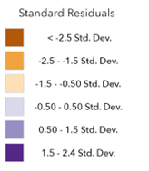
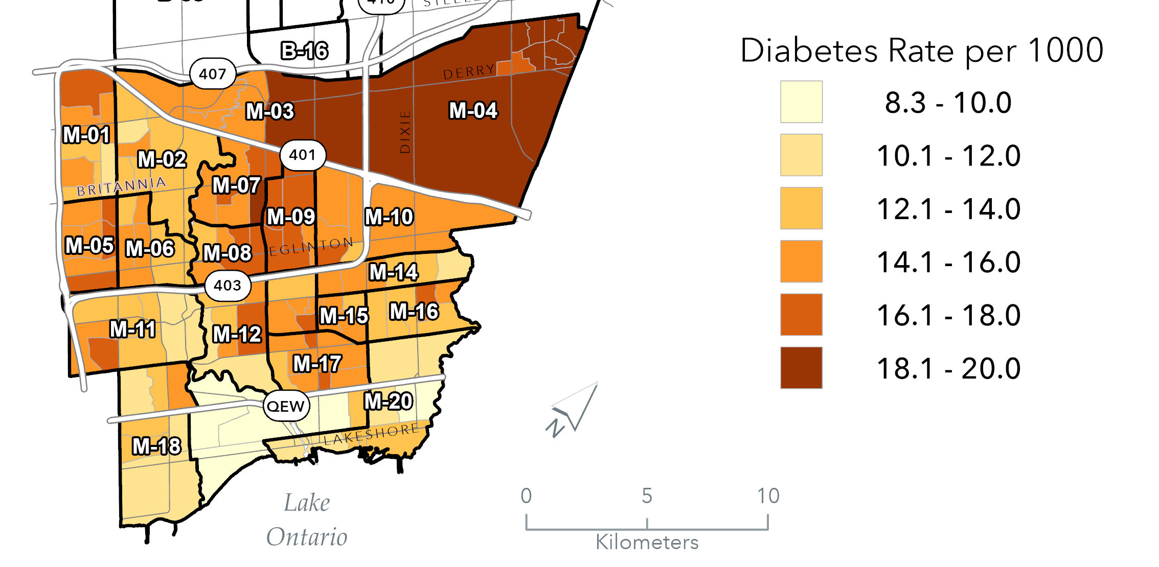
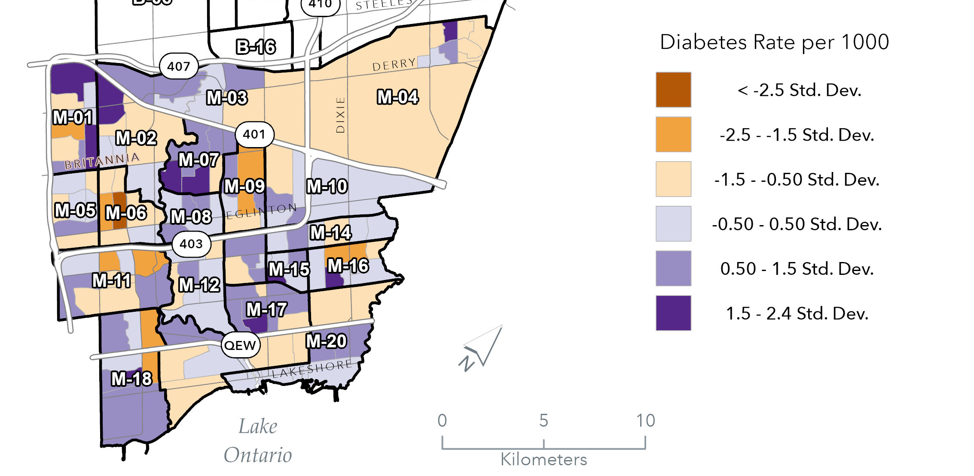
Mississauga Model
Predicted Diabetes Prevalence in Mississauga
Standardized Residuals for Mississauga
Notes:
Put this in the model diagnostics

Slide 19



Model Results for Mississauga
Socio-Economic Variables
Health Behavior Variables
Built Environment Variables
*ON-Marg Index Resources includes low-income, low education, unemployment, core housing need measures
*ON-Marg Index Racialized Newcomer includes recent immigration (2016-present), any visible minority ethnicity
**HVI Exposure includes: annual maximum mean warm-season land surface temperature; percent tree canopy coverage; mean greenest pixel
Notes:
Period of contruction

Slide 20
Model Results for Mississauga
      Neighborhoods with high visible minority populations and recent immigrants have higher diabetes prevalence.
      Long-term immigrant status is driver of diabetes prevalence.
      Education and core housing need are socio-economic driver of diabetes prevalence.
      Low-income has a strong negative association with diabetes prevalence.
      Access to a regular health care provider is a driver of diabetes prevalence; however, this variable is likely representing disease burden.
      Neighborhoods that have low shade and tree canopy coverage (HVI Exposure) have higher diabetes prevalence.

Slide 21


Model Results for Mississauga
    Neighborhoods with high visible minority populations and recent immigrants have higher diabetes prevalence:
    36.4% of Peel’s immigrants are family‑sponsored, a group that tends to be older—contradicting the typical “Healthy Immigrant Effect” (Region of Peel, 2021).
    The ON-Marg Resources Index captures other visible minority groups (Arab and Filipino) that may also drive diabetes prevalence in Mississauga.
    South Asian and Black visible minority populations are both significant independent drivers of diabetes.
    Long-term immigrant status is driver of diabetes prevalence:
    Likely due to aging, declining health, and acculturation (Adjei et al., 2020).
    Education and core housing need are both socio-economic drivers of diabetes.
    Low-income has a strong negative association with diabetes prevalence:
    Interactions with other variables may be flipping the relationship.
    Collinear with ON-MARG Racialized Newcomers, Core Housing Need, and Black and South Asian populations.
    May be representing a missing spatial variable that is not explained in the model.

Slide 22
Model Results for Mississauga
      Access to a regular health care provider is a driver of diabetes prevalence; however, this variable is likely representing disease burden.
      Areas with higher diabetes rates likely tend to have people more engaged in the health care system
      Neighborhoods that have low shade and tree canopy coverage (HVI Exposure) have higher diabetes prevalence.
      Suggests environmental barriers discourage physical activity
      Spatial marker for disadvantage – areas may be denser, co-locate with other SES factors. However, HVI Exposure is an independent risk factor.

Slide 23
Brampton and Caledon
Notes:
Moving on to the Brampton and Caledon Model

Slide 24
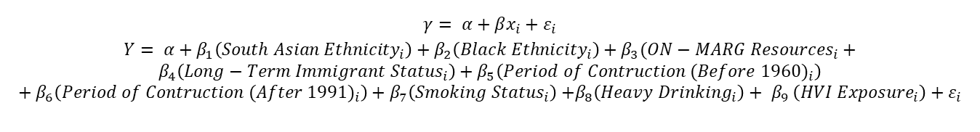
Brampton-Caledon Model
$$γ= α+βx_{i}+ε_{i}$$
$$Y= α+β_{1}\left({South Asian Ethnicity}_{i}\right)+β_{2}\left({Black Ethnicity}_{i}\right)+β_{3}({ON−MARG Resources}_{i}+ \\ β_{4}\left({Long−Term Immigrant Status}_{i}\right)+β_{5}\left({Period of Contruction (Before 1960)}_{i}\right)+β_{6}\left({Period of Contruction (After 1991)}_{i}\right)+β_{7}\left({Smoking Status}_{i}\right){+β_{8}\left({Heavy Drinking}_{i}\right)+ β}_{9}\left({HVI Exposure}_{i}\right)+ε_{i}$$
Metric | Value | Interpretation
Adjusted R² | 0.9237 | Extremely high explanatory power
AICc | 269.76 | Good model in comparison to others
Spatial Autocorrelation | p = 0.316 | Residuals are spatially random
Joint F-test | p < 0.001 | Model is significant
Koenker BP | p = 0.443 | No heteroskedasticity; robust SEs stable
Jarque–Bera | p = 0.472 | Residuals approximately normal
Largest VIF | 3.91 | No concerning multicollinearity
Notes:
The Brampton–Caledon model produced an exceptionally high adjusted R² of 0.92.

Slide 25
Brampton-Caledon Results
Covariate | Direction | Coefficient (per +1 SD)
ON-MARG: Resources | ↑ | 0.377
Smoking (current smoker) | ↑ | 0.462
Black Visible Minority | ↑ | 0.54
South Asian Visible Minority | ↑ | 1.676
Long-Term Immigrants | ↑ | 0.251
HVI Exposure | ↑ | 0.402
PoC After 1991 | ↑ | 0.342
PoC Before 1960 | ↓ | –0.293
Heavy drinkers (12+) | ↓ | –0.361
 | Expected
 | Unexpected
* ON-Marginalization Index data is measured in standard deviation units
** HVI Exposure is measured in a 0-100 scale, where 0 is the lowest and 100 is the highest score
Notes:
Comparing the two models yields several important contrasts.
Black visible minority effects were slightly higher in Brampton–Caledon (0.09 vs. 0.07).
South Asian visible minority effects were twice as large in Brampton–Caledon (0.08 vs. 0.04).
Long‑term immigrant status had stronger effects in Mississauga (0.11 vs. 0.08).
HVI Exposure contributed equally to diabetes prevalence across both models (0.02 in each).
Overall, Brampton–Caledon appears more strongly shaped by visible minority concentration and SES disadvantage captured by ON‑MARG Resources, whereas Mississauga shows a more complex interplay of settlement patterns, SES, and environmental exposures.

Slide 26
Brampton-Caledon Results
Covariate | Unit of Effect | Change in diabetes rate per 1000
ON-MARG: Resources | One SD increase | 0.80*
Smoking (current smoker) | One % point increase | 0.15
Black Visible Minority | One % point increase | 0.09
South Asian Visible Minority | One % point increase | 0.08
Long-Term Immigrants | One % point increase | 0.08
HVI Exposure | One unit increase | 0.02**
PoC After 1991 | One % point increase | 0.01
PoC Before 1960 | One % point increase | -0.04
Heavy drinkers (12+) | One % point increase | -0.23
Smoking, South Asian, Black, and ON-MARG Resources had the largest effect on diabetes prevalence
 | Expected
 | Unexpected
* ON-Marginalization Index data measured in standard deviation units
** HVI Exposure measured in 0-100 scale, where 0 is the lowest and 100 is the highest score

Slide 27
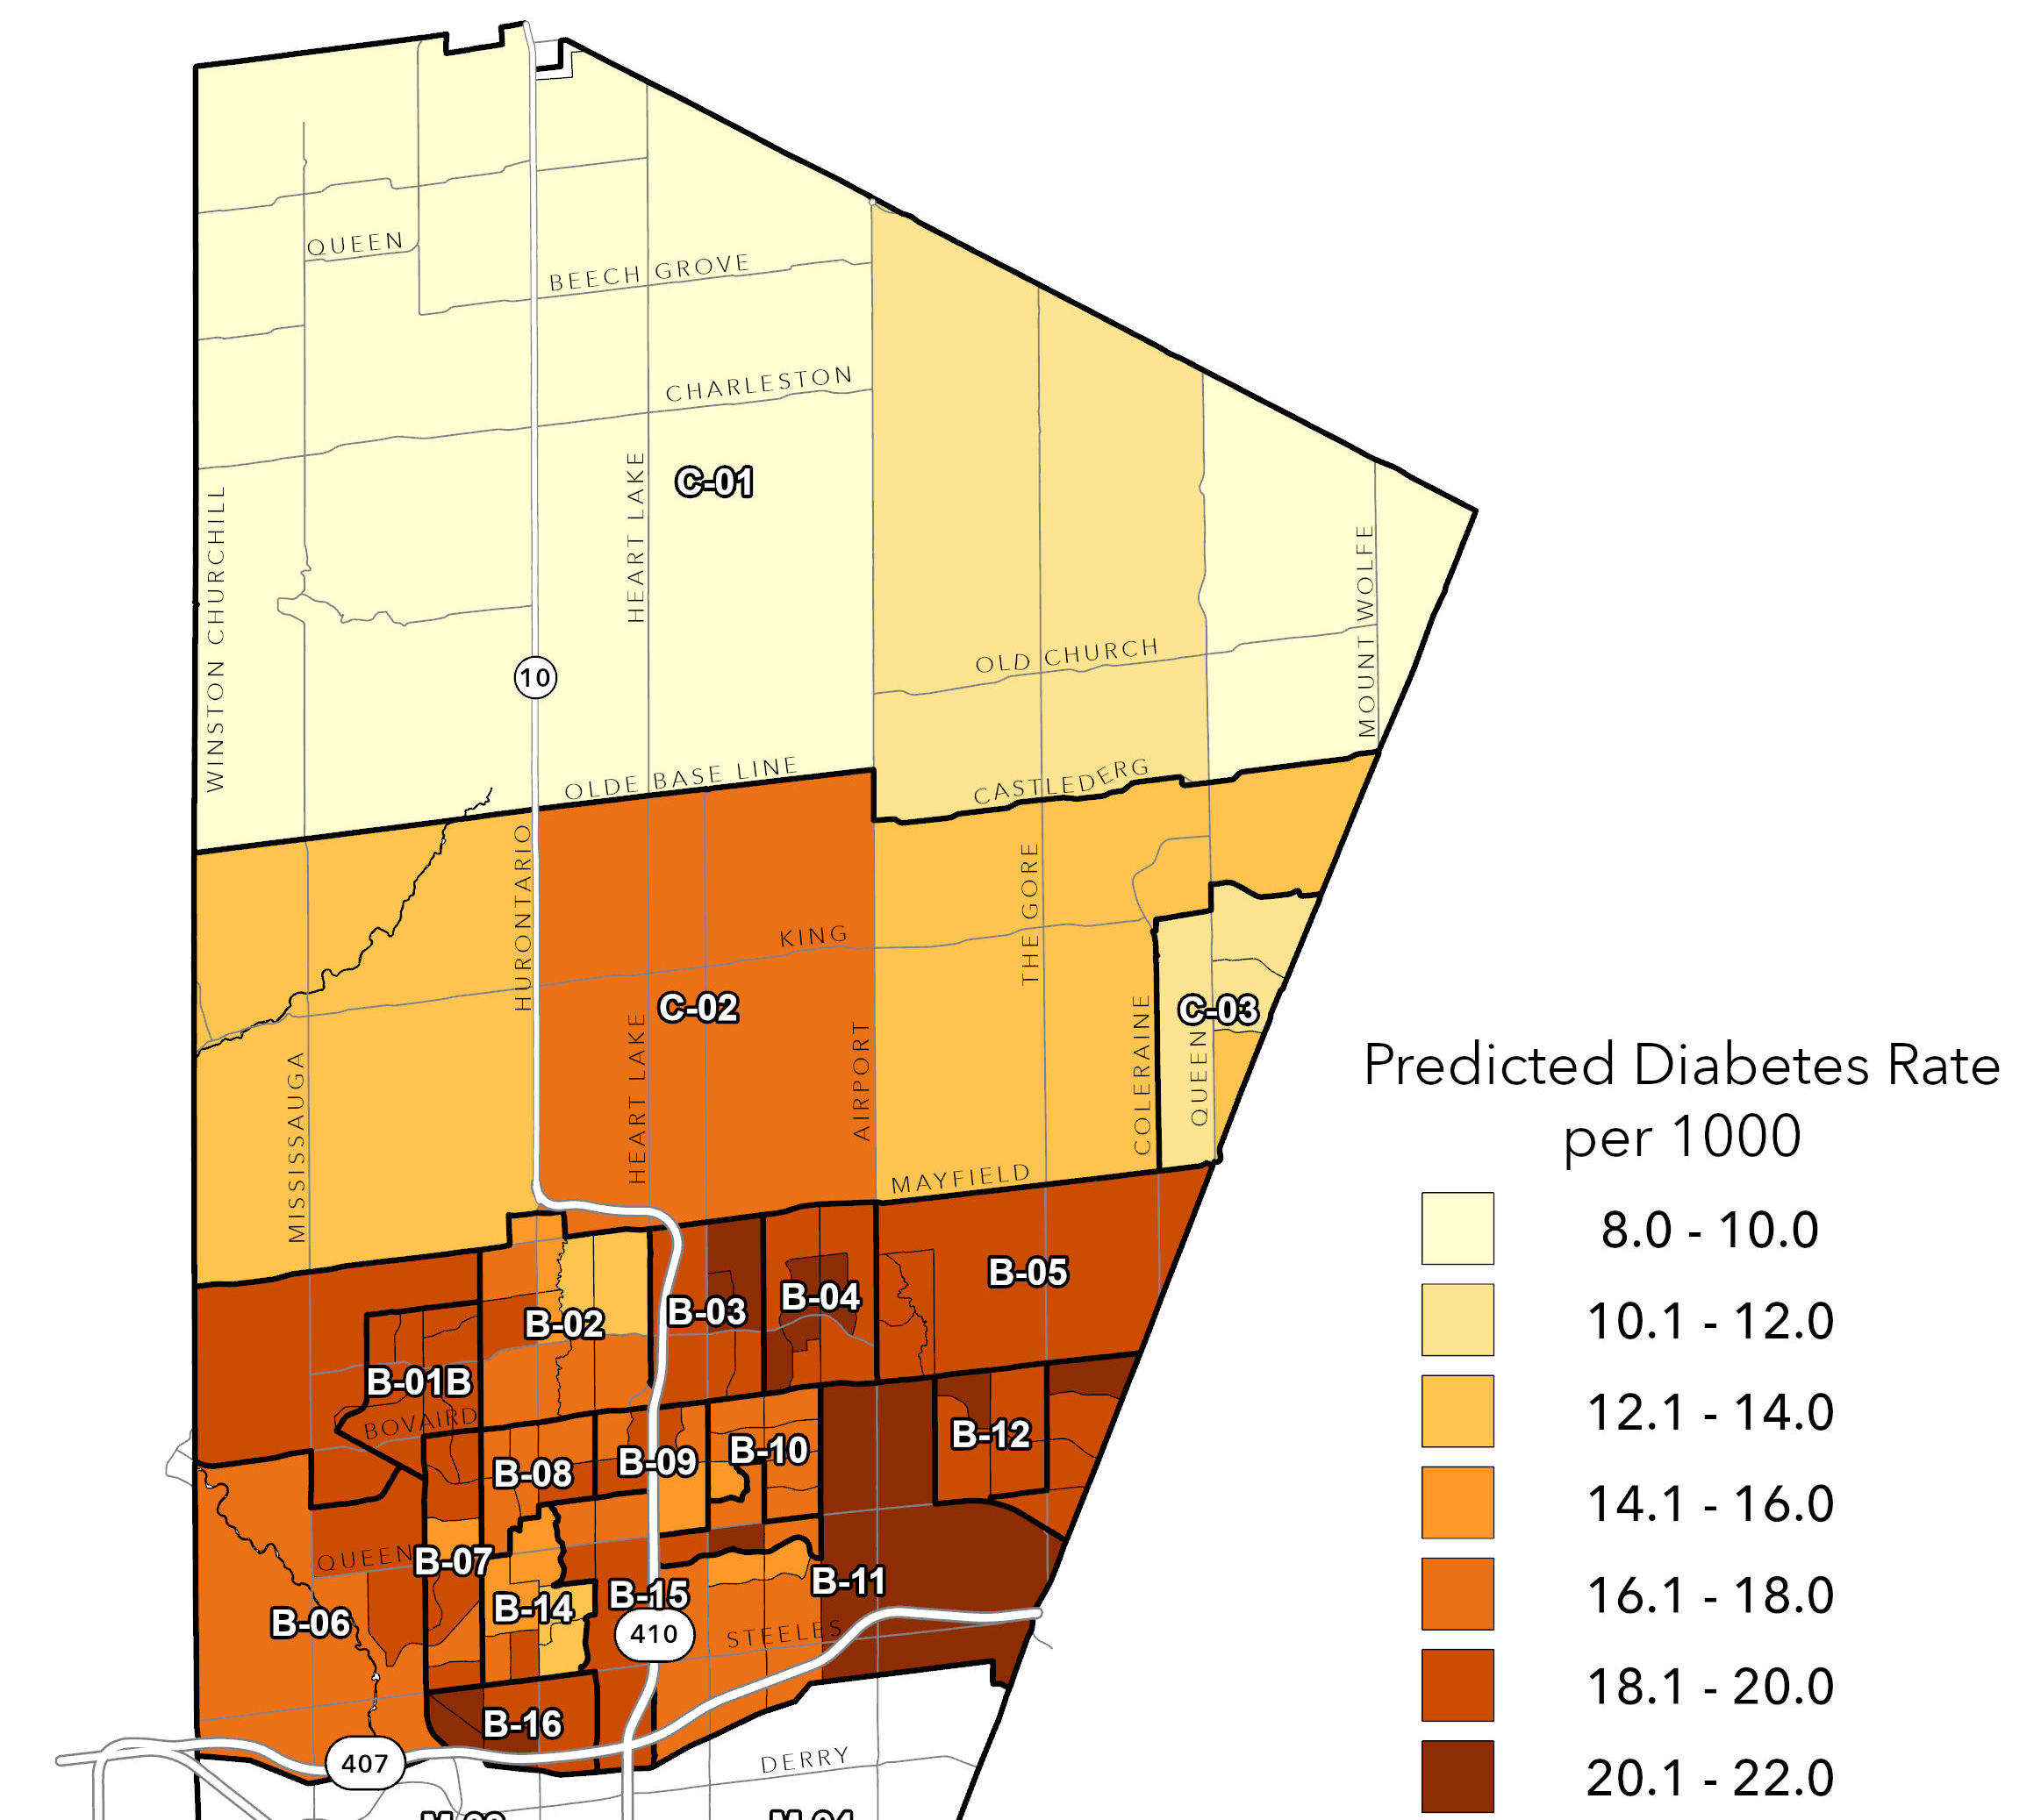
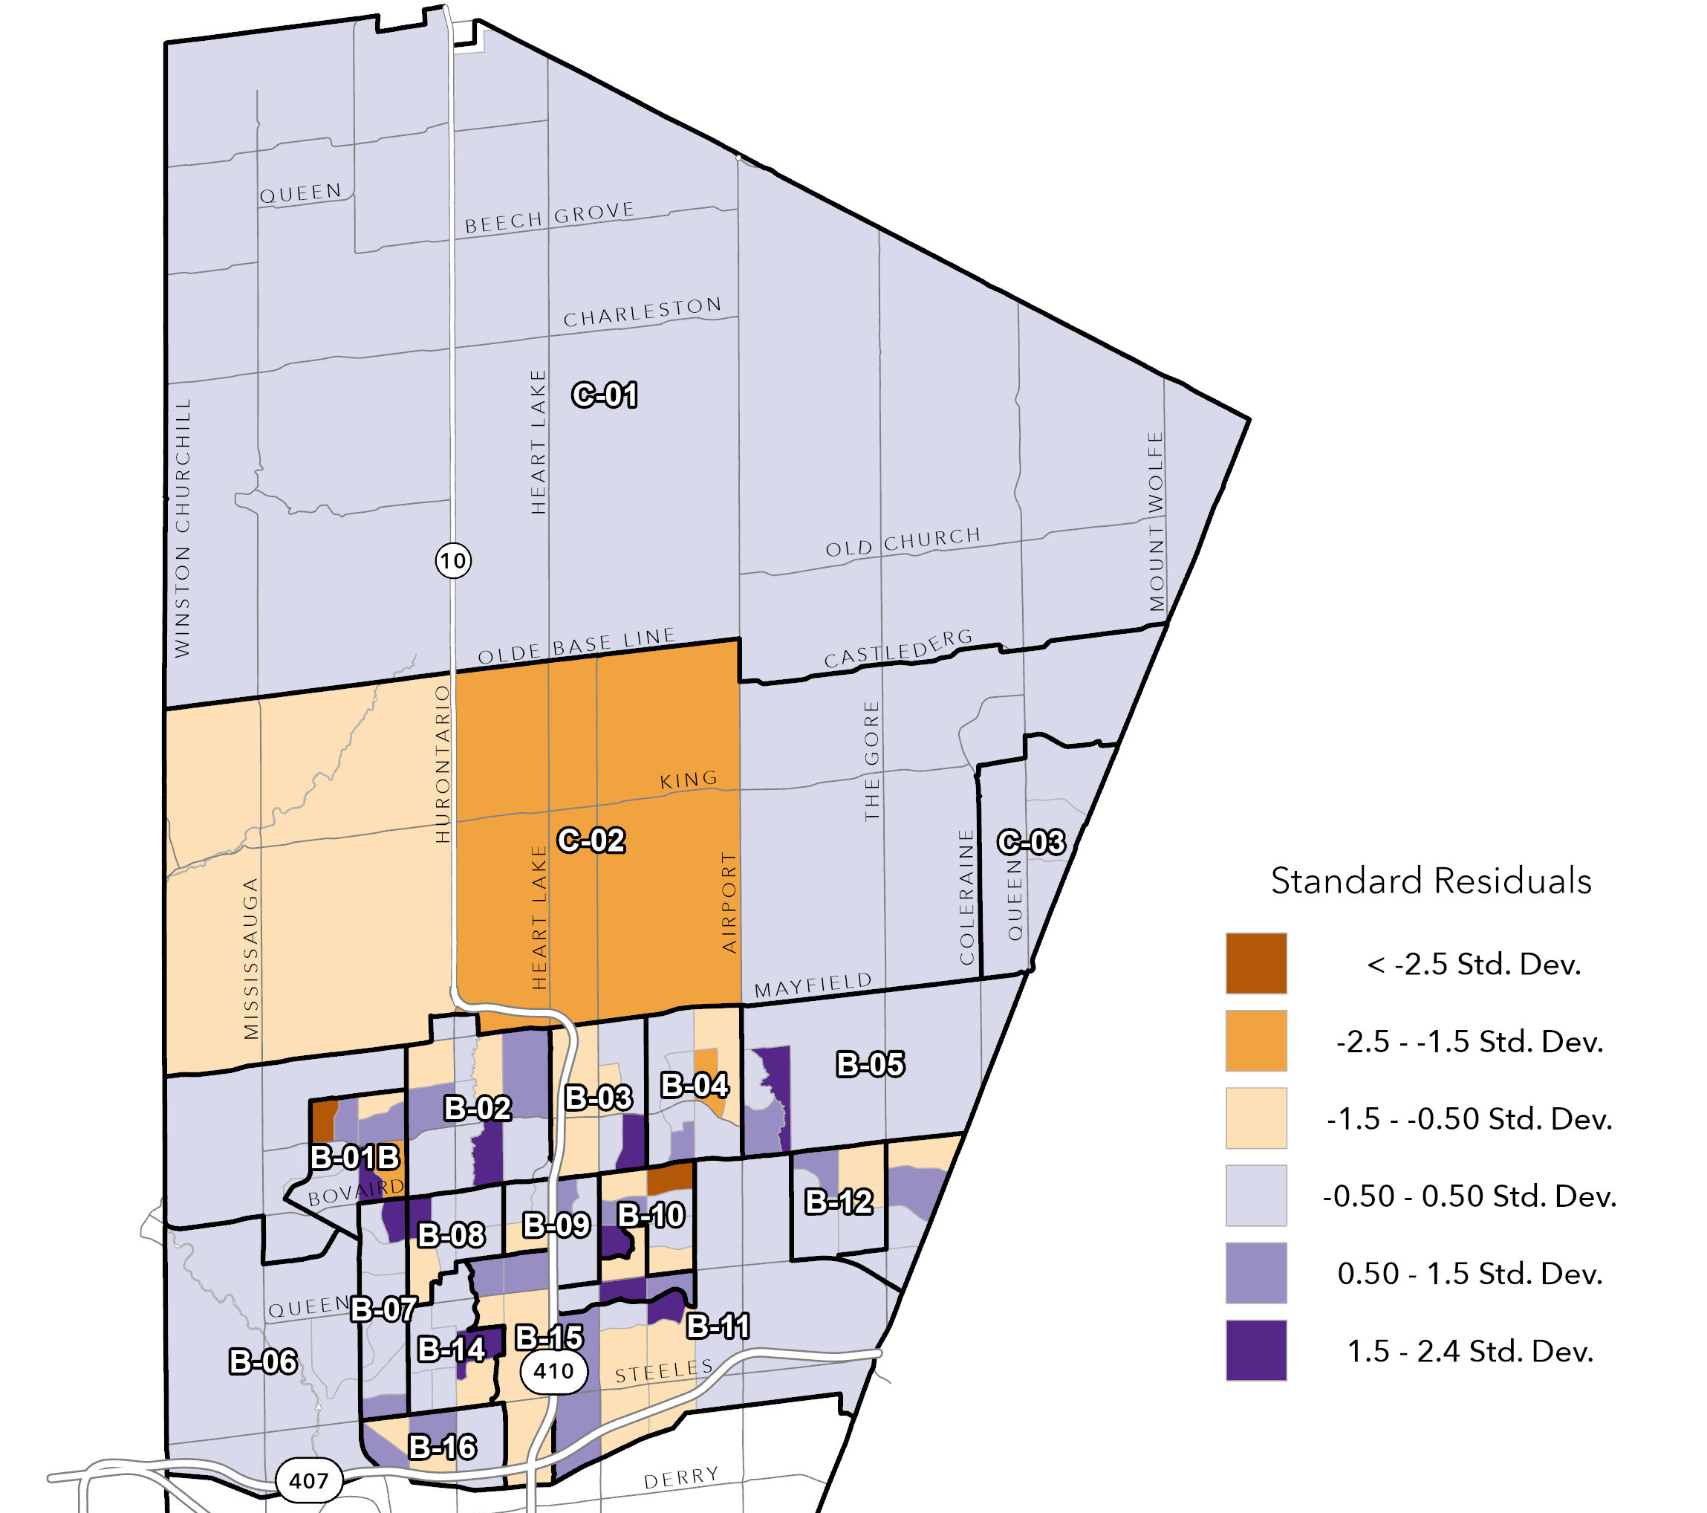
Brampton-Caledon Model
Predicted Diabetes Prevalence in Brampton-Caledon
Standardized Residuals for Brampton-Caledon
Notes:
The standardized residuals show over and underpredictions of the model.
Mention the differences in scales

Slide 28



Model Results for Mississauga
Socio-Economic Variables
Health Behavior Variables
Built Environment Variables
*ON-Marg Index Resources includes low-income, low education, unemployment, core housing need measures
**HVI Exposure includes: annual maximum mean warm-season land surface temperature; percent tree canopy coverage; mean greenest pixel
Notes:
Period of contruction

Slide 29
Brampton-Caledon Model Results
      Neighborhoods with socio‑economically marginalized populations have higher diabetes prevalence (ON-Marg Resources Index).
      South Asian and Black visible minority populations independently predict higher diabetes rates.
      Neighborhoods with long‑term immigrants have a higher diabetes prevalence.
      Smoking shows a positive association with higher diabetes prevalence.
      Heavy drinking (binge drinking more than once a month) shows a negative association with diabetes prevalence.
      HVI Exposure predicts higher diabetes prevalence.
      PoC After 1991 (newer, suburban neighborhoods) predicts higher diabetes prevalence.
      PoC Before 1960 (older, walkable neighborhoods) predicts lower diabetes prevalence.

Slide 30

Brampton-Caledon Model Results
      Smoking shows a positive association with higher diabetes prevalence.
      This aligns with previous literature on contribution to vascular and metabolic dysfunction (Pan et al., 2015).
      Heavy drinking (binge drinking more than once a month) shows a negative association with diabetes prevalence.
      This may be reflecting socioeconomic and demographic differences.
      This also may be because low-moderate levels of alcohol consumption is shown to have a protective effect in females (Knott et al., 2015).
      HVI Exposure predicts higher diabetes prevalence.
      Environmental stressors and reduced opportunities for outdoor physical activity contribute to risk (Ge et al., 2023).
      PoC After 1991 (newer, suburban neighborhoods) predicts higher diabetes prevalence.
      Consistent with car‑dependency, low walkability, and limited local services typical of newer subdivisions.
      PoC Before 1960 (older, walkable neighborhoods) predicts lower diabetes prevalence.
      Reflects older, more connected neighbourhood designs that may support healthier behaviours and has populations with higher SES.

Slide 31
Comparing Mississauga and Brampton-Caledon Models
The Brampton-Caledon model explains more variance in diabetes prevalence compared to the Mississauga model (R-squared values: 92% vs 87%).
Black visible minority:
Brampton & Caledon shows a slightly stronger effect than Mississauga (0.09 vs 0.07).
South Asian visible minority:
Brampton & Caledon has twice as strong effect compared to Mississauga (0.08 vs 0.04).
Long Term Immigrants:
Settled immigrant communities show higher accumulated risk in both, but the effect is stronger in Mississauga (0.08 vs 0.11).
HVI Exposure:
High greenness, low temperature heat and high tree canopy contributes similarly to diabetes prevalence in both regions (0.02 in both models).
Notes:
South Asian and Black visible minority effects are notably larger in Brampton–Caledon, long‑term immigrant effects are stronger in Mississauga, and heat vulnerability (HVI) contributes equally across both models.
Black Visible Minority
Brampton–Caledon: Stronger effect (0.09)
Mississauga: Slightly weaker (0.07)
South Asian Visible Minority
Brampton–Caledon: Much stronger effect (0.08)
Mississauga: Smaller effect (0.04)
Long‑Term Immigrants
Mississauga: Slightly stronger (0.11)
Brampton–Caledon: Moderate (0.08)
HVI Exposure (Heat, Canopy, Vegetation)
Identical across both models: 0.02

Slide 32
Conclusion
Peel is shaped by socio‑economic marginalization, immigrant settlement patterns, ethno‑racial composition, built environment characteristics, and environmental exposures.
These findings highlight the need for municipality‑specific strategies rather than regional one‑size‑fits‑all approaches.
Notes:
In conclusion, diabetes prevalence in Peel is shaped by a combination of socio‑economic marginalization, immigrant settlement patterns, ethno‑racial composition, built environment characteristics, and environmental exposures.
These findings highlight the need for municipality‑specific strategies rather than regional one‑size‑fits‑all approaches.
For example:
Brampton–Caledon would benefit from strategies addressing suburban development, SES disadvantage, and culturally tailored diabetes prevention.
Mississauga would require targeted interventions in thermally vulnerable, lower‑education, and racially diverse neighbourhoods.
This geospatial approach provides a framework to support evidence‑informed planning and equitable health policy within the region.

Slide 33
Thank you
Any questions?

Slide 34
References
Adjei, J. K., Adu, P. A., & Ackah, B. B. B. (2020). Revisiting the healthy immigrant effect with diabetes risk in Canada: why race/ethnicity matters. Ethnicity & Health, 25(4), 495–507. https://doi.org/10.1080/13557858.2019.1567697
Ge, H., & Wang, J. (2023). Spatial Non-Stationarity Effects of Unhealthy Food Environments and Green Spaces for Type-2 Diabetes in Toronto. Sustainability, 15(3), 1762. https://doi.org/10.3390/su15031762
Knott C., Bell S., Britton A. (2015). Alcohol Consumption and the Risk of Type 2 Diabetes: A Systematic Review and Dose-Response Meta-analysis of More Than 1.9 Million Individuals From 38 Observational Studies. Diabetes Care, 38 (9): 1804–1812. https://doi.org/10.2337/dc15-0710
Pan A., Wang Y., Talaei M. et al. (2015). Relation of active, passive, and quitting smoking with incident type 2 diabetes: a systematic review and meta-analysis. The Lancet Diabetes & Endocrinology, 3, 958-967. https://doi.org/10.1016/S2213-8587(15)00316-2
Region of Peel. (2021). Immigration, citizenship and mobility: Portrait of citizenship and immigration in Peel in 2021. Peel Data Portal. https://census.peelregion.ca/pages/immigration-citizenship-and-mobility-2021
Region of Peel. (2021). Ethnic Diversity and Religion:
Peel's diverse community in 2021. Peel Data Portal. https://census-regionofpeel.hub.arcgis.com/pages/ethnic-diversity-and-religion-2021
Region of Peel. (2021). Population and Dwelling Counts:
Peel's growing population and where they live in 2021. Peel Data Portal. https://census-regionofpeel.hub.arcgis.com/pages/population-and-dwellings-2021

